Slide 1
Outdoor Air Quality
4/26/2023
Marilyn V. Howarth, MD, FACOEM
Director, Community Engagement Core
Adrian Wood, MPH
Coordinator, Community Engagement Core

Slide 2

Indoor Air Monitoring
Monitoring:
Temperature
Humidity
PM2.5
What is a comfortable temp and humidity indoors?
  68-72 degrees
  40-50% humidity
Notes:
What raises particulate indoor…etc
Come up with list that is relevant to school (pollen, dust from people shoes, dirt in the ventilation system, cooking, art room with debris, lab, 3D printer)
What is the same as the house and what we have at school and not at the home
-------
Start with this --

Slide 3
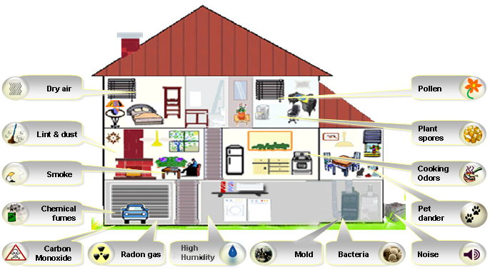
Indoor PM2.5 levels
Average outdoor PM2.5 level is 8ug/m3
What raises indoor PM2.5 levels at school?
Notes:
What raises particulate indoor…etc
Come up with list that is relevant to school (pollen, dust from people shoes, dirt in the ventilation system, cooking, art room with debris, lab, 3D printer)
What is the same as the house and what we have at school and not at the home
There is no standard for amount of particulates inside, are no indoor air standards for anything
Only thing we have is knowing average is 8 outdoors, would like it to be better inside
Measure levels below 8
Where in the school we want to measure?
-

Slide 4
Air Quality in Indoor Environments
External sources
Building structure
Interior furnishings
Mechanical systems
Occupants
Notes:
All sources effect indoor environment –
school buses near where air comes in, factory next door,
Fiberglass insulation, asbestos
When they get new piece of furniture – comes with smell, chemicals coming off dyes- materials used, goes away over time
MS: ventilation in the school, ducts: air pulled in from the outside, air comes in from the roof pulled into vent system and has ducts sometimes have air moving through them, when heating/cooling not on is no movement, PM settles, when turns on again gets pushed through, if have heating system that runs on fossil fuel, oil/gas, if not working properly can create carbon monixde – kills people, odorless, no way to know w/o detector, anyone with gas, oil, important to have CO monitors, wherever you sleep
Occupants: smoking, personal care products, PM shuffling around, pesticides, cleaners inside, CO

Slide 5
Health Effects Often Attributed to Poor IAQ
Irritation of mucous membranes
Headache
Lethargy
Sinus congestion

Slide 6
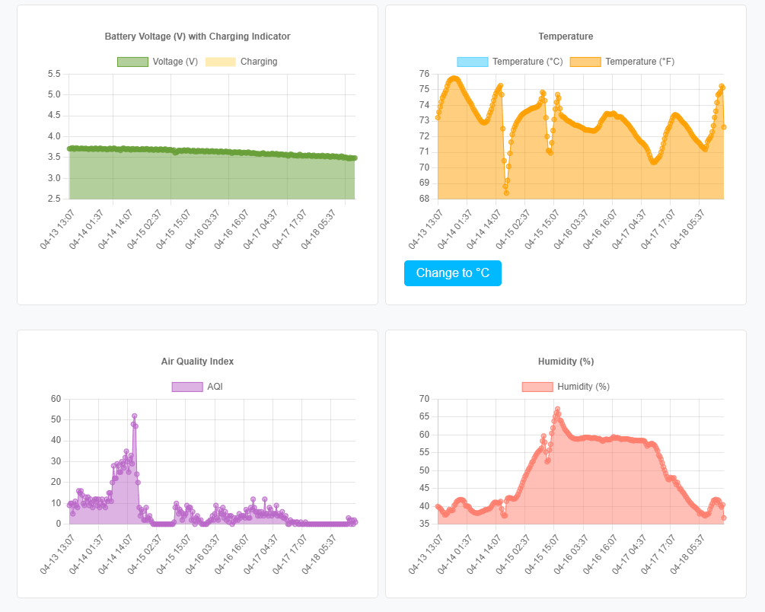
Indoor monitor 4/13 – 4/19

Slide 7
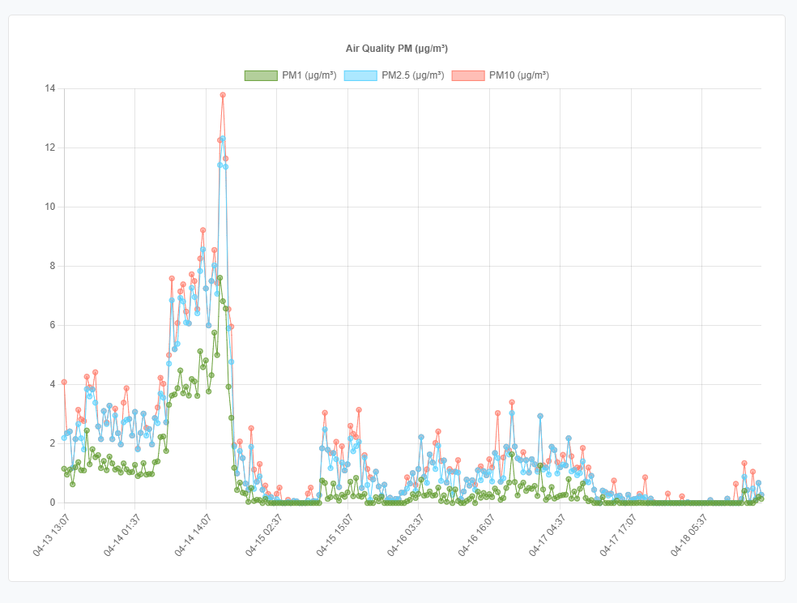
Indoor monitor 4/13 – 4/19
Friday 4/14 ~1-3pm

Slide 8

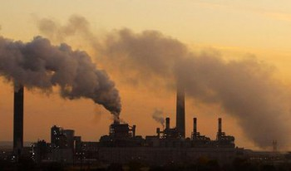
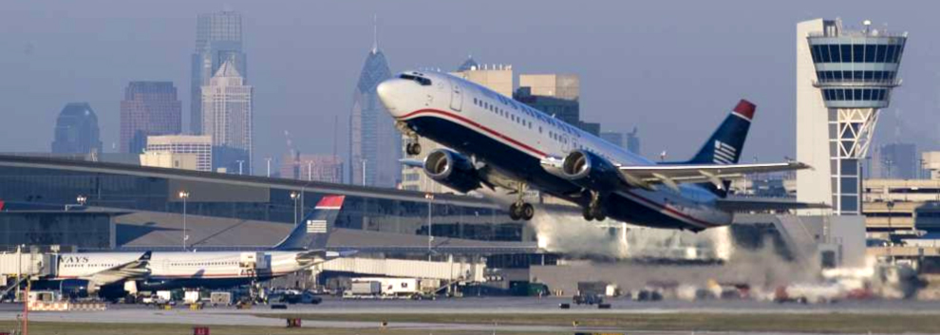
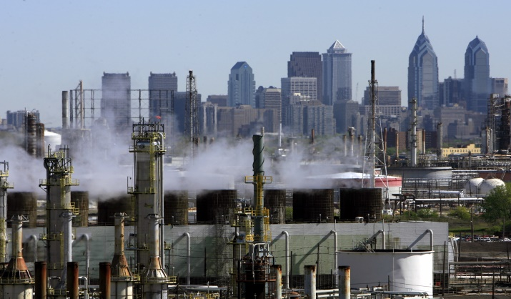
Sources of Poor Outdoor Air Quality
Auto Exhaust
Coal-Fired Power Plants
Airports
Oil Refineries

Slide 9

How Does Poor Outdoor Air Quality Affect Your Health?

Slide 10


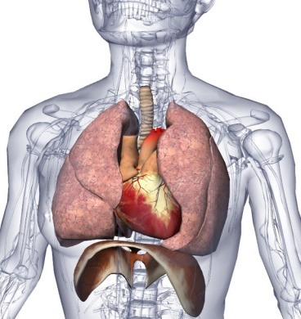
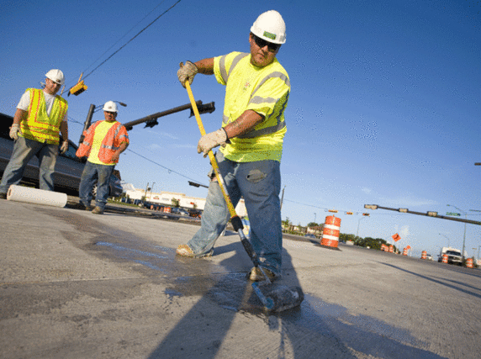
Sensitive Groups
Groups especially sensitive to pollution include:
Children
Elderly
People with heart and lung disease
People who work outside during the Summer.

Slide 11
Combined Effects of Environmental Exposure
Asthma
Nitrogen oxides
Ozone
Particulates (PM 2.5)
Sulfur dioxide
Pollen
Mold
Cockroach allergens
Smoking
Hazardous Air Pollutants
Aldehydes
Anhydrides
Isocyanates
Metals
Chlorine
Styrene

Slide 12
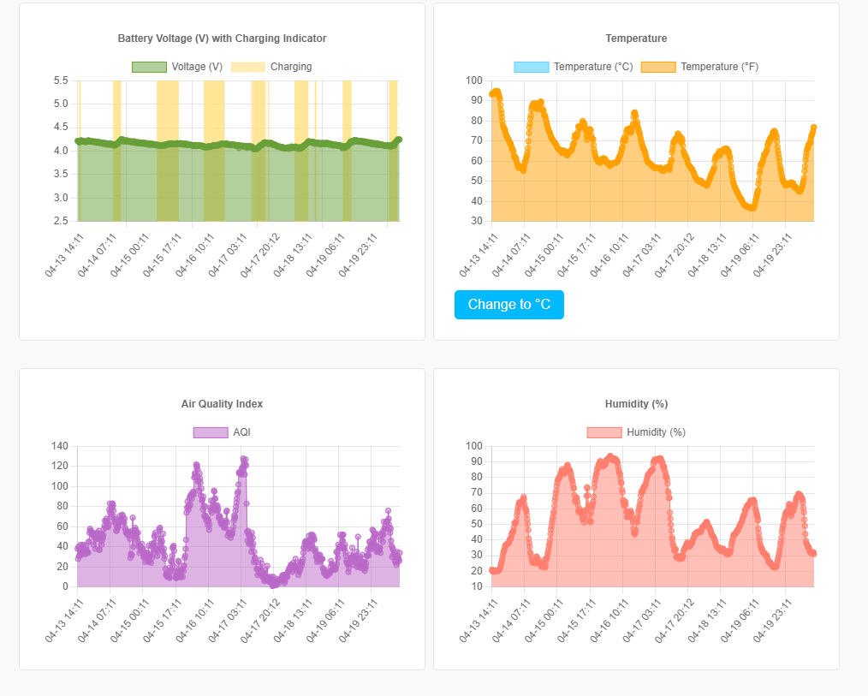
Outdoor monitor 4/13 – 4/19

Slide 13
4/13 – 4/19
Outdoor monitor
Indoor monitor

Slide 14
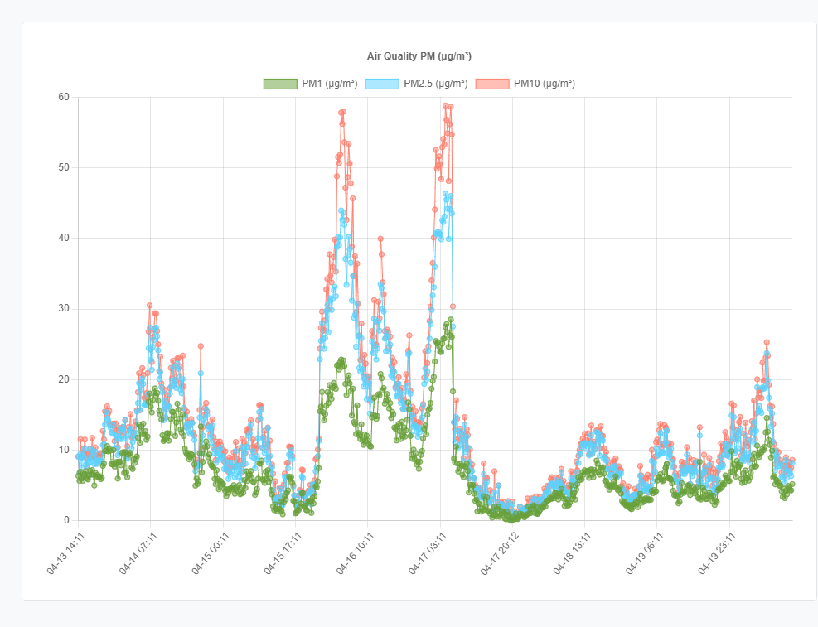
Outdoor monitor 4/13 – 4/19
Notes:
Add links

Slide 15
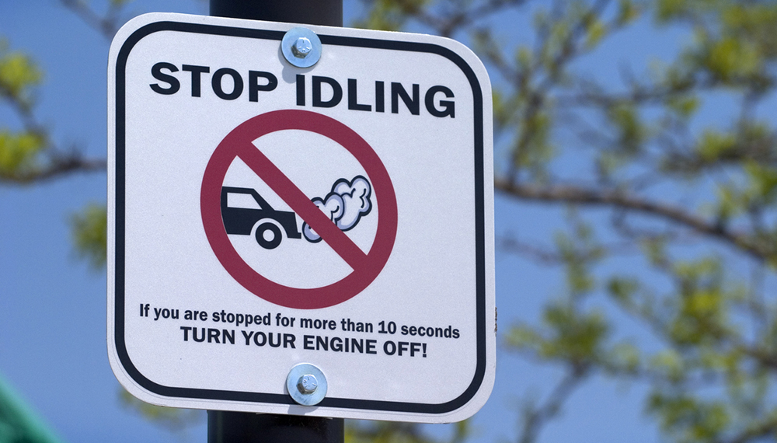
Activity: How much gas is used when you idle?

Slide 16
How to calculate how much gasoline is used by an idling vehicle
Different sized engines consume gas at different rates when they are idling.
Vehicle Type (Engine Size in Liters) | Idling Fuel Use (with no car accessories, like AC or radio, running)
Light-duty gasoline-fueled vehicles (passenger vehicles) | 0.0053 gal/min (or 0.32 gal/hr)
Light-duty gasoline-fueled trucks (pick-up trucks, SUVs, minivans) | 0.0118 gal/min (or 0.71 gal/hr)
To calculate how much gasoline is used by an idling vehicle:
(total minutes idling) x (gal/min) = Gallons of Gas

Slide 17
Example: Calculate the total amount of gas consumed while idling by a woman driving a sedan for one week.
Typical daily schedule:
7am: While driving her child to school, she picks up another student at their house. She idles for 9 minutes outside their house.
7:15am: While waiting in the drop-off line at school, she idles for 12 minutes.
12pm: She leaves work to grab some lunch. She leaves her car running for 8 minutes while she runs into a convenience store.
3:30pm: While waiting in the pick-up line at school, she idles for 14 minutes.

Slide 18
Example: Calculate the total amount of gas consumed while idling by a woman driving a sedan for one week.
Sedan: light-duty gasoline-fueled vehicle (0.0053 gal/min)
(total minutes idling) x (gal/min) = Gallons of Gas
Typical daily schedule:
7am: 9 minutes
7:15am: 12 minutes
12pm: 8 minutes
3:30pm: 14 minutes
43 minutes x 0.0053 gal/min = 0.2279 gal/day

Slide 19
Example: Calculate the total amount of gas consumed while idling by a woman driving a sedan for one week.
0.2279 gal/day x 180 school days/year = 41.022 gals/year
41.022 gals/year x $3.719/gallon = $152.56 spent on gas idling
Notes:
41 gals of emissions – gone into the air, saving the money and emissions to air near school/house

Slide 20
Dashboards
Outdoor
https://airnote.live/dev:864475044271996/dashboard
Indoor
https://airnote.live/dev:864475044270501/dashboard

Slide 21
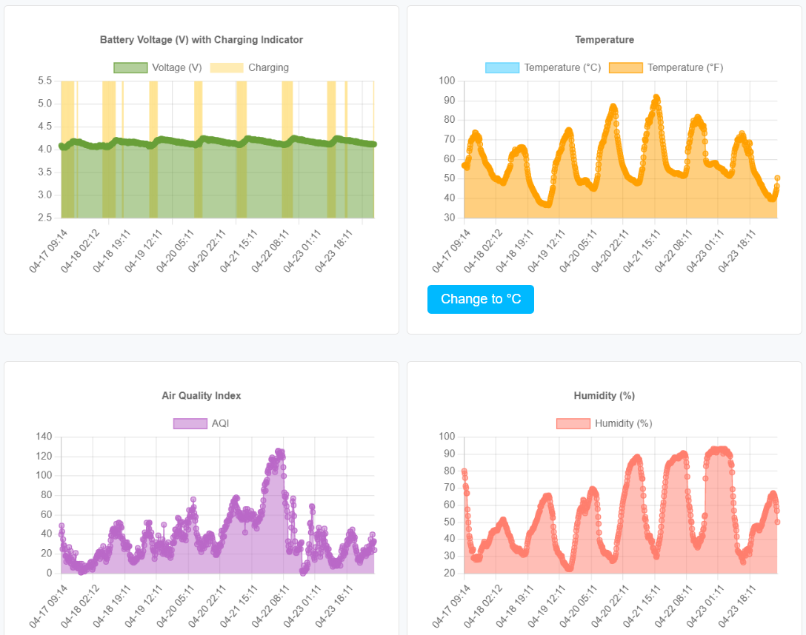
Outdoor monitor 4/17 – 4/23

Slide 22
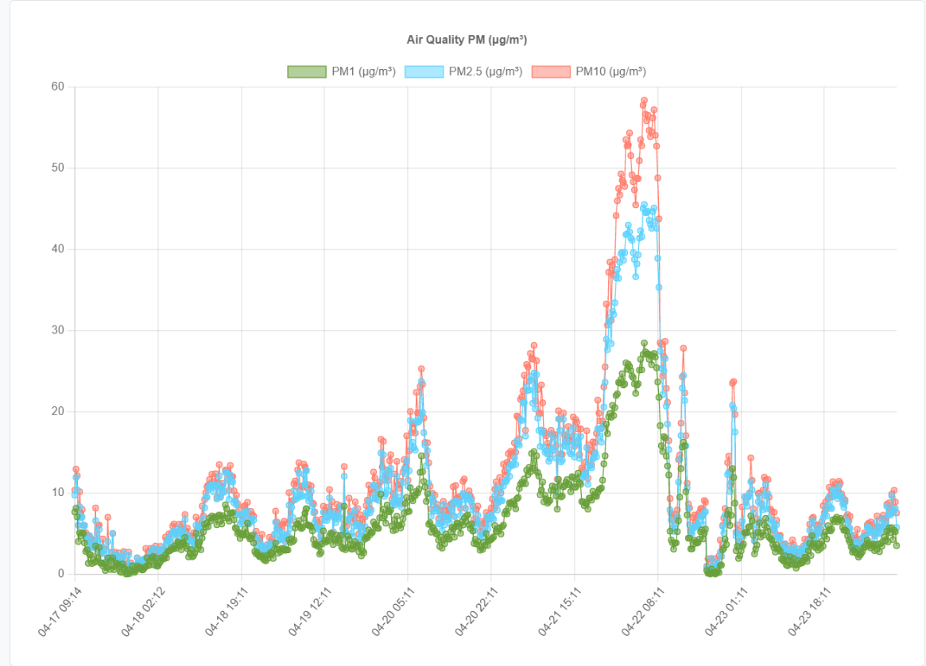
Outdoor monitor 4/17 – 4/23

