Slide 1
Poor Indoor Air Quality
Preventable Health Impacts
Marilyn V. Howarth, MD, FACOEM
Director, Community Engagement Core
Adjunct Associate Professor
Systems Pharmacology and Translational Therapeutics

Slide 2
Air Quality in Indoor Environments
External sources
Building structure
Interior furnishings
Mechanical systems
Occupants
Notes:
All sources effect indoor environment –
school buses near where air comes in, factory next door,
Fiberglass insulation, asbestos
When they get new piece of furniture – comes with smell, chemicals coming off dyes- materials used, goes away over time
MS: ventilation in the school, ducts: air pulled in from the outside, air comes in from the roof pulled into vent system and has ducts sometimes have air moving through them, when heating/cooling not on is no movement, PM settles, when turns on again gets pushed through, if have heating system that runs on fossil fuel, oil/gas, if not working properly can create carbon monixde – kills people, odorless, no way to know w/o detector, anyone with gas, oil, important to have CO monitors, wherever you sleep
Occupants: smoking, personal care products, PM shuffling around, pesticides, cleaners inside, CO

Slide 3
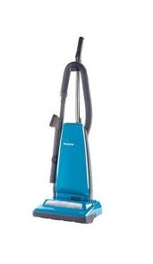
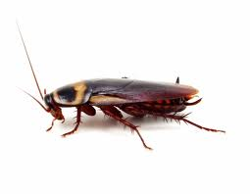
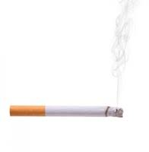
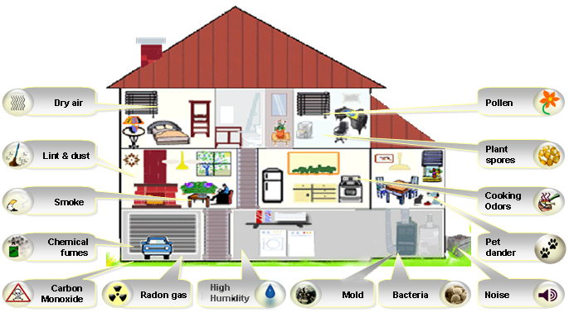
Exposures at HOME
Notes:
w/o heap filter, 1/3 dust comes out other end, spread around again
Pests leave proteins around house
---
Talk about which of these things do we have in the school?
Kitchen: don’t really cook, it’s the cooking that spreads particulate, warming not spreading,

Slide 4
Health Effects Often Attributed to Poor IAQ
Irritation of mucous membranes
Headache
Lethargy
Sinus congestion

Slide 5
Combined Effects of Environmental Exposure
Asthma
Nitrogen oxides
Ozone
Particulates (PM 2.5)
Sulfur dioxide
Pollen
Mold
Cockroach allergens
Smoking
Hazardous Air Pollutants
Aldehydes
Anhydrides
Isocyanates
Metals
Chlorine
Styrene

Slide 6
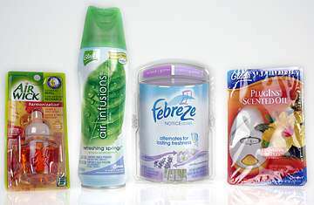
Myths about Indoor Air Quality
Air Fresheners clean the air
NO!! They contain fragrances and other chemicals that worsen asthma

Slide 7
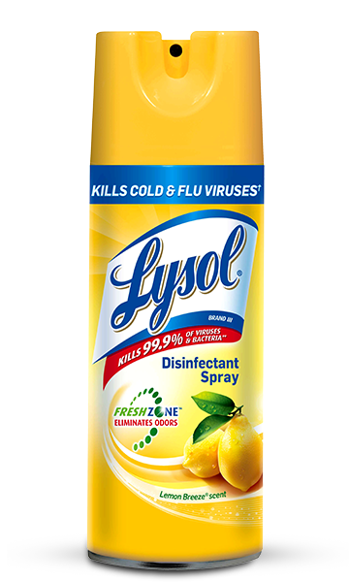
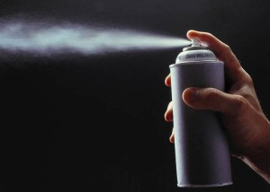
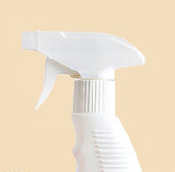
Myths about Indoor Air Quality
It’s a good idea to spray aerosol disinfectants into the air to eliminate bacteria and viruses
NO!!! These products are intended to be sprayed on surfaces not in the air. They contain alcohol, aldehydes and fragrances which can exacerbate asthma. Aerosols should not be used in schools because the tiny particles stay in the air for hours and penetrate lungs deeply
Better Choice

Slide 8
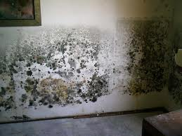
Mold
Every inside and outside environment has mold
Mold grows is large amounts only when there is water intrusion and humidity remains >50%
Notes:
This is a lot of mold – not the same to have a tiny amount in bathroom, etc
Everyone has a little bit of mold.. In damp places

Slide 9
Illness Caused by Mold
Anyone can become allergic to mold if the exposure is great or long lasting
Individuals with allergies are more likely to become allergic to mold
Exacerbation of allergy leading to asthma can occur with ongoing exposure

Slide 10
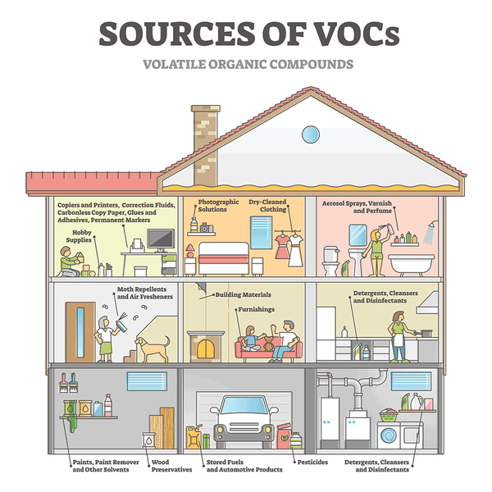
Volatile Organic Compounds
Many VOCs are known or possible human carcinogens (benzene and formaldehyde)
Irritants that exacerbate asthma and chronic pulmonary conditions
Indoor smoking increases VOCs
Other significant variables such as emissions from furnishings, cleaning products, air fresheners
Notes:
Picture: fabric furniture/carpet

Slide 11
Ventilation and Respiratory Aerosols
Increasing air changes per hour
- decreases viral transmission - decreases school absences - decreases infection rates in hospital settings
Notes:
Ventilation is nec bc it dilutes anything coming up into the air and decreases the likelihood viruses are transmitted
Pollen: opening windows during high pollen, could be worse for the occupants if you have building ventilation
Building: making the vent system run more and bringing in fresh air, viruses breathed out by people who are sick,

Slide 12
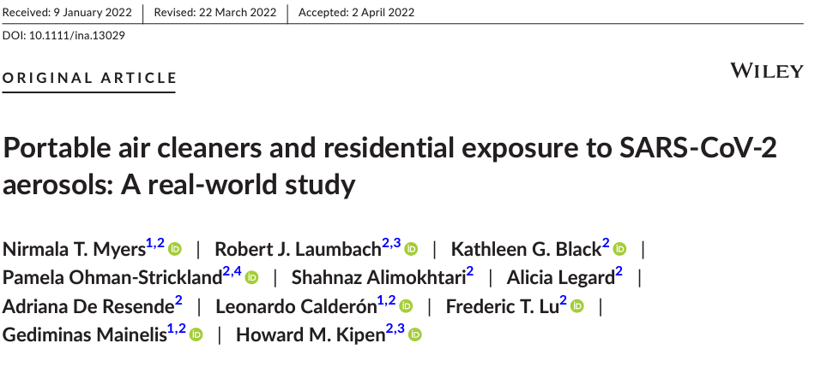
Filtration and Respiratory Aerosols
Notes:
Add image: air purifier in home setting
If you have indoor air filters, if has someone with covid and put an air filter in room, household less likely to get infected
If you have a source and put ventilation in the room – prevents spread

Slide 13
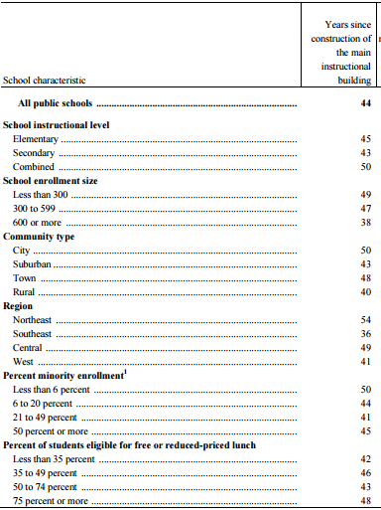
Age of School Buildings in US
Schools earn a “D” grade from the American Society of Civil Engineers 2013 Report Card for America’s Infrastructure
National Center for Education Statistics 2012-2013

Slide 14
Philadelphia School District (PSD) Snap shot
347 Buildings – Includes 86 Charter Schools & about 215 Neighborhood Public Schools
210,000 students - Includes 60,000 Charter School Students
8th Largest U.S. School District by Enrollment
17,000 – 20,000 employees
Average Building Age = 66 Years;
Average Roof Age = 40 Years [10-20 year lifespans]
25 Buildings More than 100 Years Old
$4 Billion in Total Capital Needs

Slide 15
Why are schools in poor condition?
Aging infrastructure – Delayed Maintenance
Densely Populated [4x Typical Office Bldg.]
Extremely Tight Budgets & Competing Priorities
Limited/No Regulation
No accountability beyond school district
Inventive and Changing Use of Spaces

Slide 16
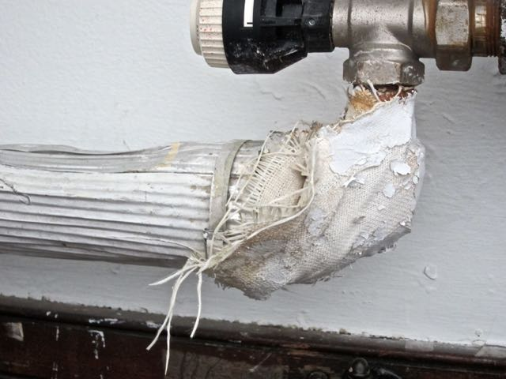
Asbestos

Slide 17
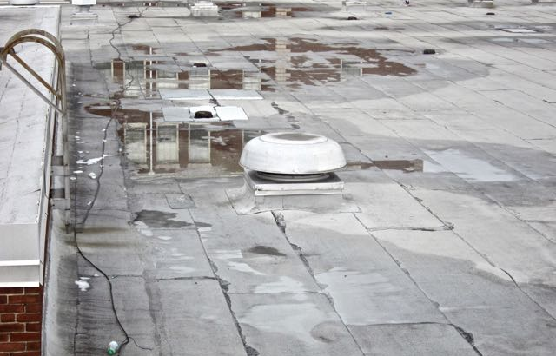
Roof Problems

Slide 18
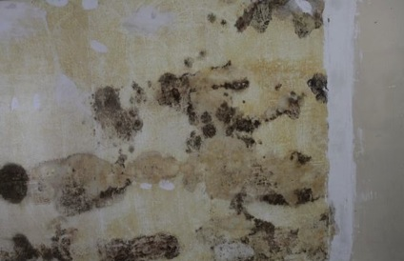
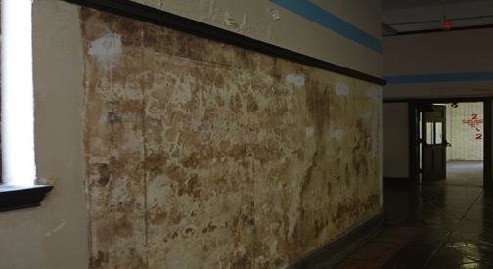
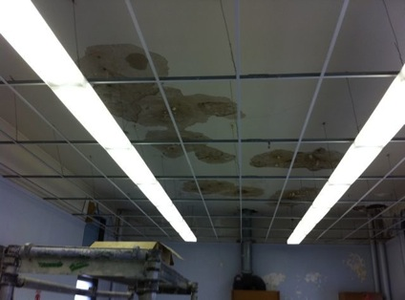
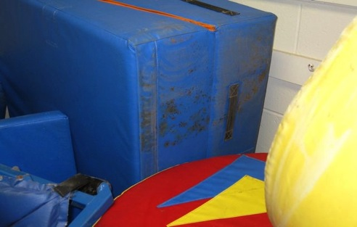
Mold Growth

Slide 19
What can be done about this situation in schools?

Slide 20
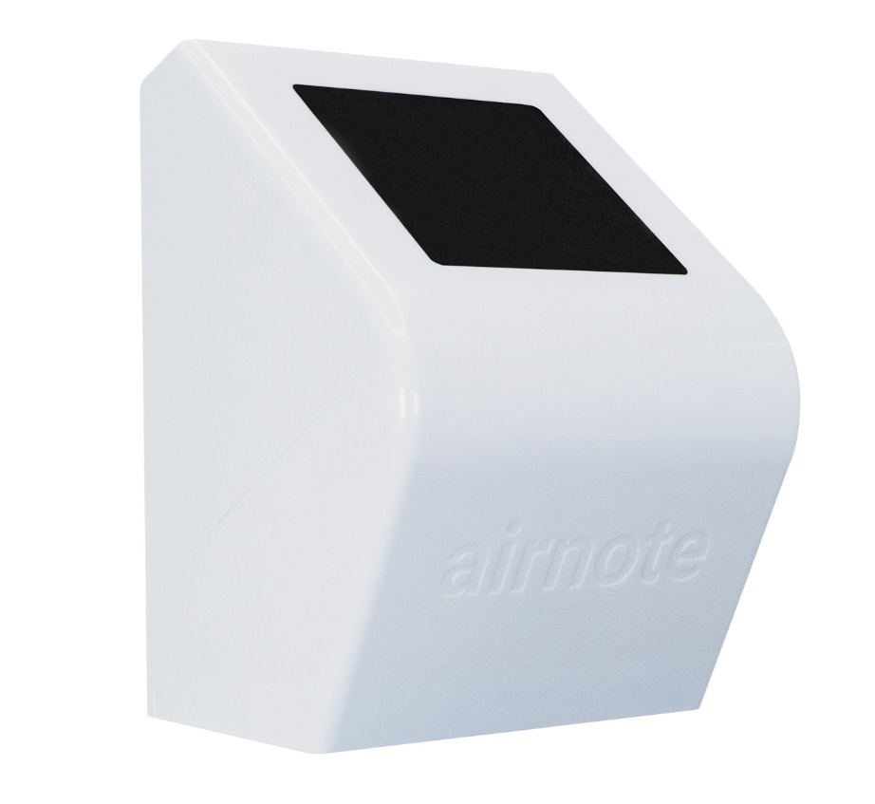
Indoor Air Monitoring
Monitoring:
Temperature
Humidity
PM2.5
What is a comfortable temp and humidity indoors?
68-72 degrees
40-50% humidity
Notes:
What raises particulate indoor…etc
Come up with list that is relevant to school (pollen, dust from people shoes, dirt in the ventilation system, cooking, art room with debris, lab, 3D printer)
What is the same as the house and what we have at school and not at the home

Slide 21
Indoor PM2.5 levels
Average outdoor PM2.5 level is 8ug/m3
What raises indoor PM2.5 levels at school?
Notes:
What raises particulate indoor…etc
Come up with list that is relevant to school (pollen, dust from people shoes, dirt in the ventilation system, cooking, art room with debris, lab, 3D printer)
What is the same as the house and what we have at school and not at the home
There is no standard for amount of particulates inside, are no indoor air standards for anything
Only thing we have is knowing average is 8 outdoors, would like it to be better inside
Measure levels below 8
Where in the school we want to measure?
-

Slide 22
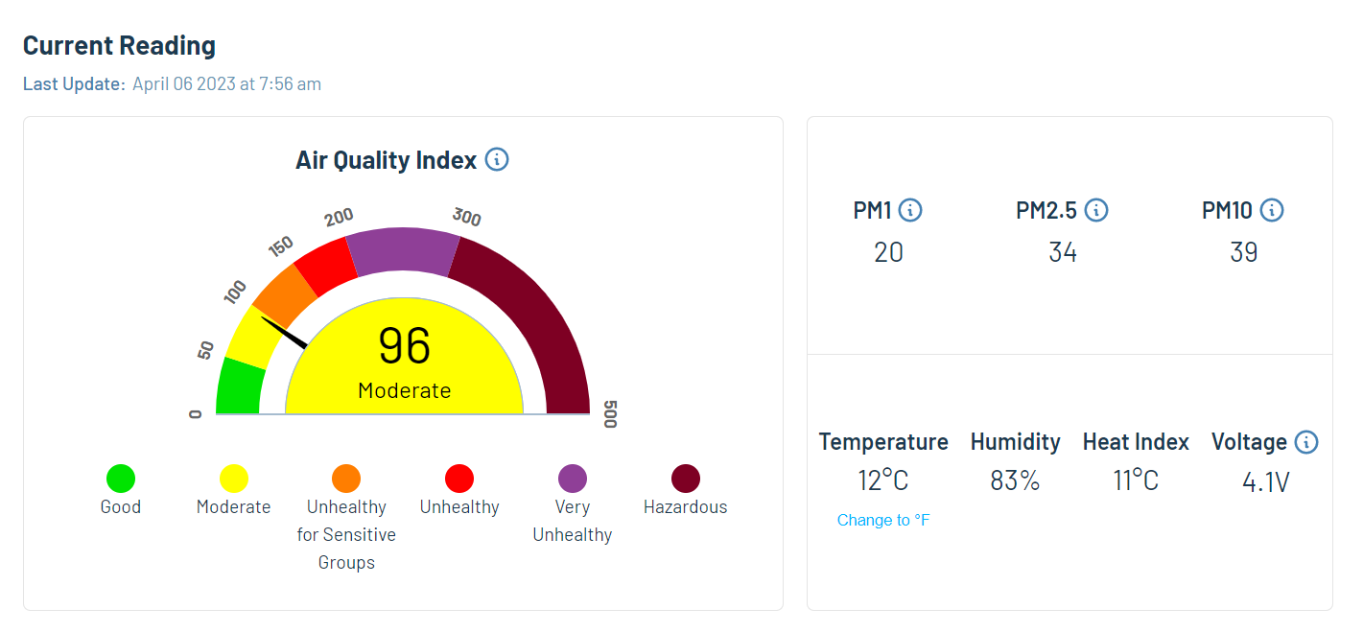
AirNote

Slide 23
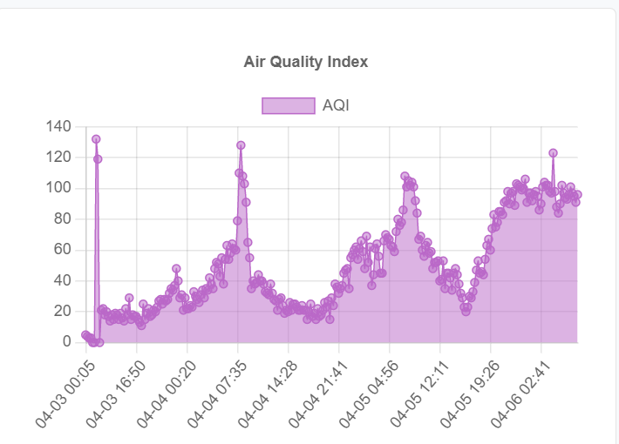
AirNote

Slide 24
Dashboards
Outdoor
https://airnote.live/dev:864475044271996/dashboard
Indoor
https://airnote.live/dev:864475044270501/dashboard

Slide 25



https://www.facebook.com/CECatCEET
@UPennCEET_CEC

