Slide 1


Air Pollution and Health
Marilyn V. Howarth, MD, FACOEM
Director, Community Engagement Core
Adrian Wood, MPH
Coordinator, Community Engagement Core

Slide 2
What is Environmental Health?
Environmental Health: Branch of public health that is concerned with all aspects of the natural and built environment that may affect human health

Slide 3
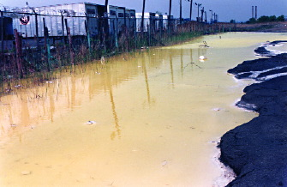
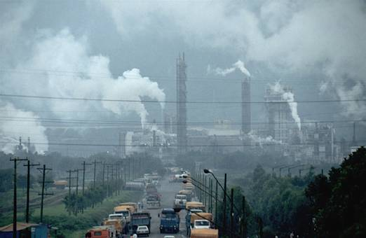
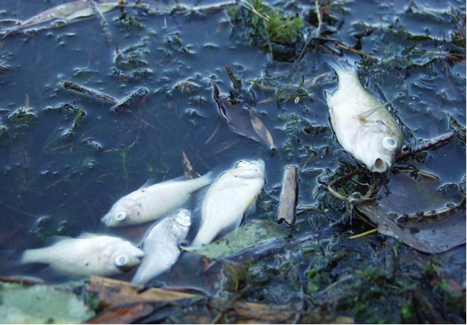
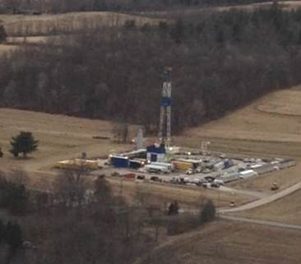
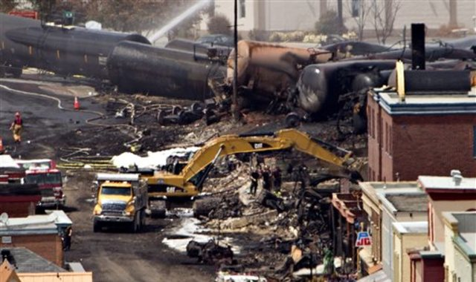
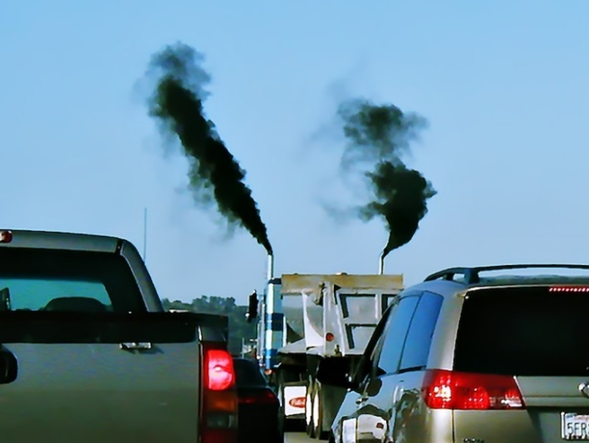
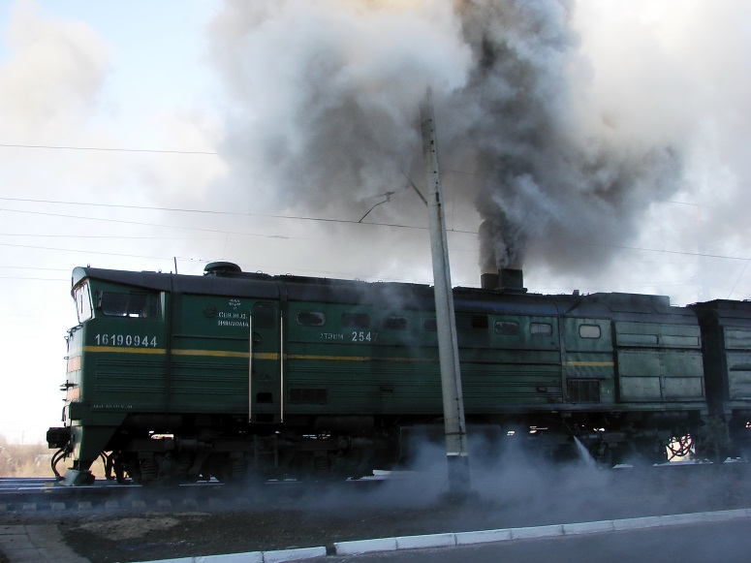

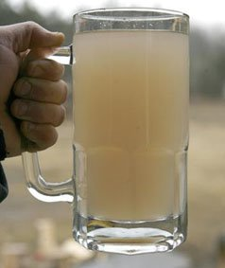
Exposures in Communities
Trucks

Slide 4
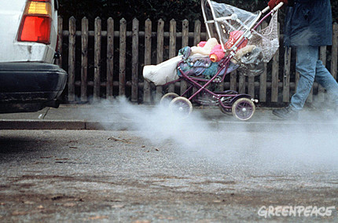
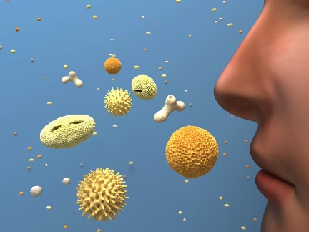
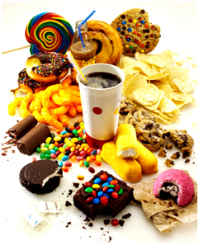

How are people exposed by their environments?
Breathing
Eating and drinking
Touching

Slide 5

Health Effects from Environmental Exposures
Asthma
Lung Disease
Cardiovascular Disease
Autism
Breast Cancer
Cancer
Lupus
Parkinson’s Disease
Neurologic Disorders
Reproductive Impacts

Slide 6
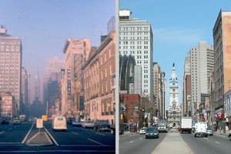
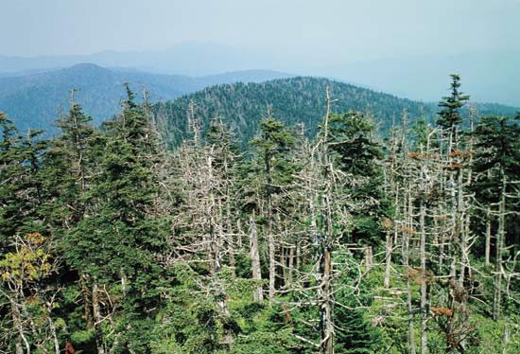
What is Air Pollution?
Substances in the atmosphere that damage the environment, human health or quality of life

Slide 7
Primary vs Secondary Air Pollutants
Primary: emitted directly into the atmosphere by an identifiable source
Particles
Sulfur compounds
Nitrogen compounds
Carbon monoxide
Lead
Secondary: formed in the air by chemical reaction in the atmosphere
Ozone, formaldehyde
PAN (peroxyacetyl nitrate)

Slide 8
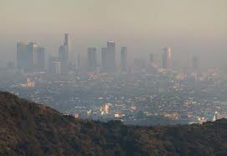
Secondary Pollutants
Ozone- in stratosphere occurs naturally, protects us from UV radiation
Ground level ozone formation requires hot temps, light wind and sunlight
NOx + VOCs + sunlight => O₃
Nitrogen oxides (NOx): fuel combustion (motor vehicles, coal power plants)
Volatile Organic Compounds (VOCs): Paints, Pesticides, Gasoline vapors and naturally occurring

Slide 9
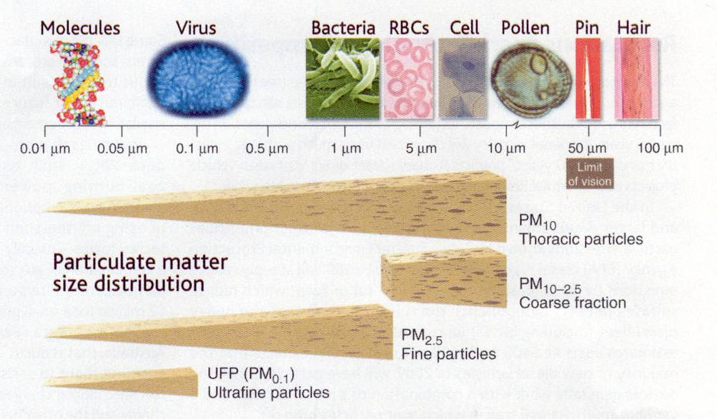

Slide 10
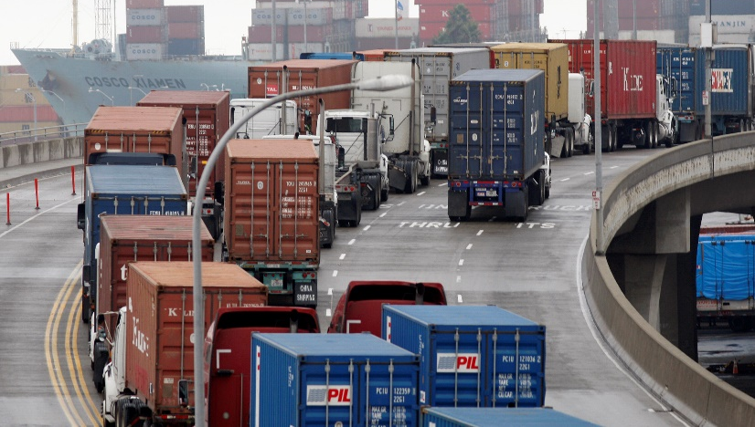
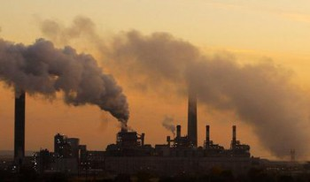
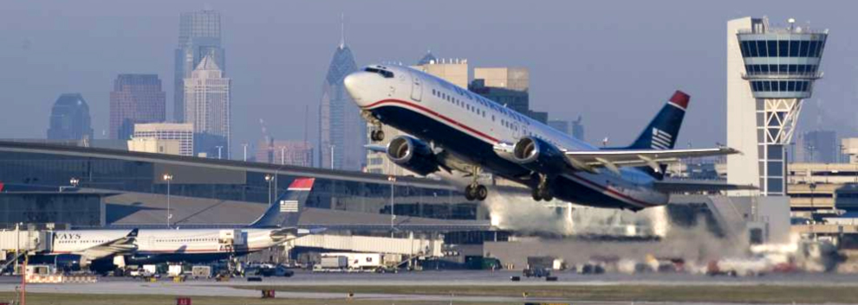
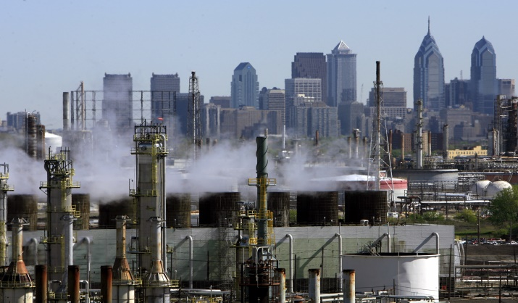
Sources of Poor Outdoor Air Quality
Auto Exhaust
Coal-Fired Power Plants
Airports
Oil Refineries

Slide 11



Does anyone control industry air pollution?
Yes
Clean Air Act…
A law designed to protect human health and the environment from the effects of air pollution.
Cut ground-level ozone, a dangerous component of smog, by more than 25 percent since 1980;

Slide 12
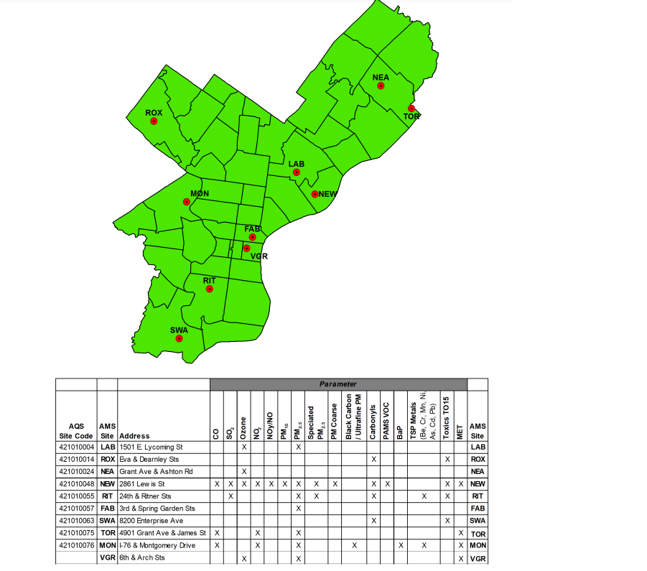
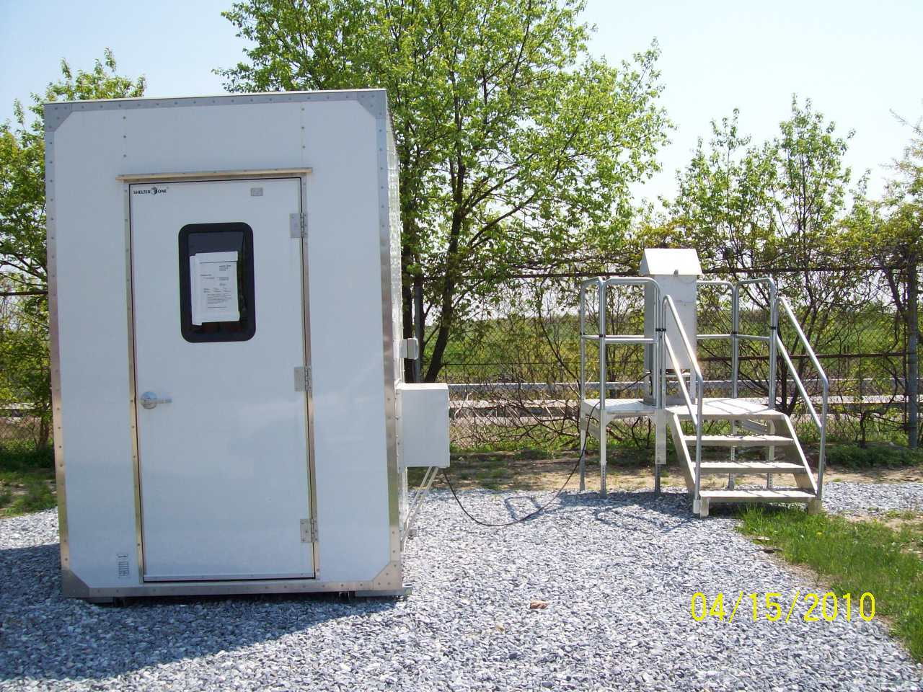
2021 AMS Monitoring Network
Not all neighborhoods are monitored
Notes:
Change to most current monitor, put Imhotep on the map

Slide 13
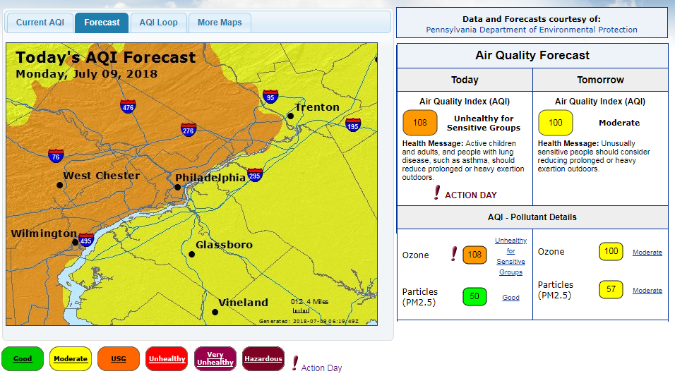
The EPA Tests The Air
www.airnow.gov
www.airqualitypartnership.org
Notes:
The EPA tests air all the time and has created a way to receive alerts. These sites measure ozone and fine particulate levels

Slide 14

How Does Poor Outdoor Air Quality Affect Your Health?

Slide 15


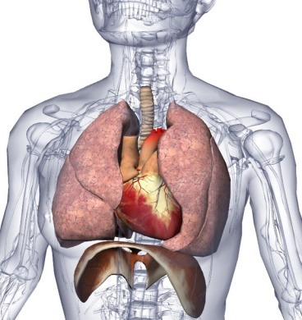

Sensitive Groups
Groups especially sensitive to pollution include:
Children
Elderly
People with heart and lung disease
People who work outside during the Summer.

Slide 16
Combined Effects of Environmental Exposure
Asthma
Nitrogen oxides
Ozone
Particulates (PM 2.5)
Sulfur dioxide
Pollen
Mold
Cockroach allergens
Smoking
Hazardous Air Pollutants
Aldehydes
Anhydrides
Isocyanates
Metals
Chlorine
Styrene

Slide 17
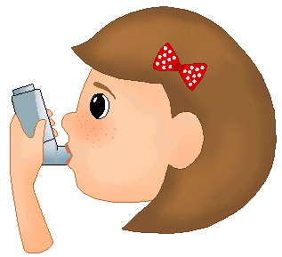


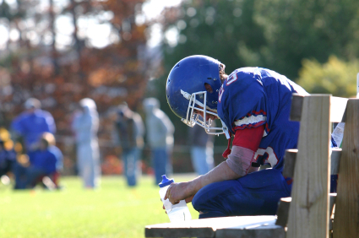
Asthma and Breathing Problems
Smoggy Environment
Missed Outdoor Play
Missed School Days
Notes:
A smoggy environment creates consequences. Poor outdoor air quality increases asthma and breathing problems, especially in children. Children in your school are more likely to miss school and outdoor play.

Slide 18
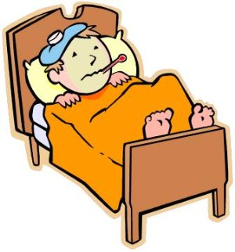
Breathing Problems
Poor outdoor air quality causes asthma attacks
Philadelphia has 2-3 times as much asthma as the rest of Pennsylvania.
Asthma is the third-ranking cause of hospitalization among children
Notes:
Possible questions from audience: **** What defines a child. Under 18? A 5 year old may react differently from a 17 year old.**** Why is Philly asthma so high?**** Humidity contributes to asthma, but is it considered a type of poor outdoor air quality? Philadelphia has an exceptionally high instance of childhood asthma

Slide 19

Missed School Days
Students dealing with asthma and breathing problems are more likely to miss school.
Missed social interactions
Lowered self esteem
Missed school work---hard to make up
10.5 million school days are missed every year due to asthma.
Notes:
Teachers need to make up lessons for sick children. This creates more work.

Slide 20
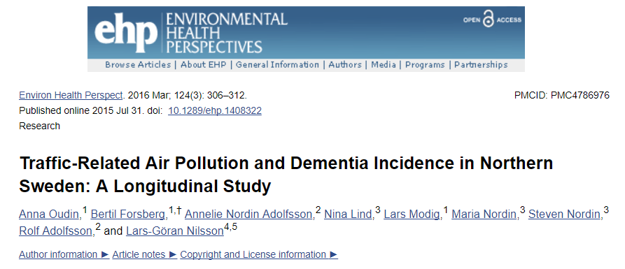
Chronic air pollution exposure decreases cognitive function
Chronic air pollution exposure may increase risk for developing Alzheimer’s and other dementia

Slide 21
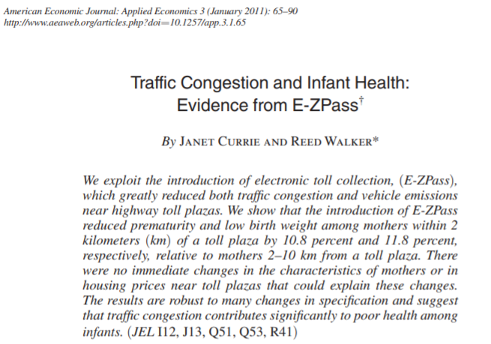
Prematurity and Low Infant Birth Weight
Introduction of EZ PASS led to 10.8% reduction of prematurity and 11.8% reduction of low birth weight within 2 km of the toll plaza
Decreased CO and NO_{x}
Interventions matter to health

Slide 22
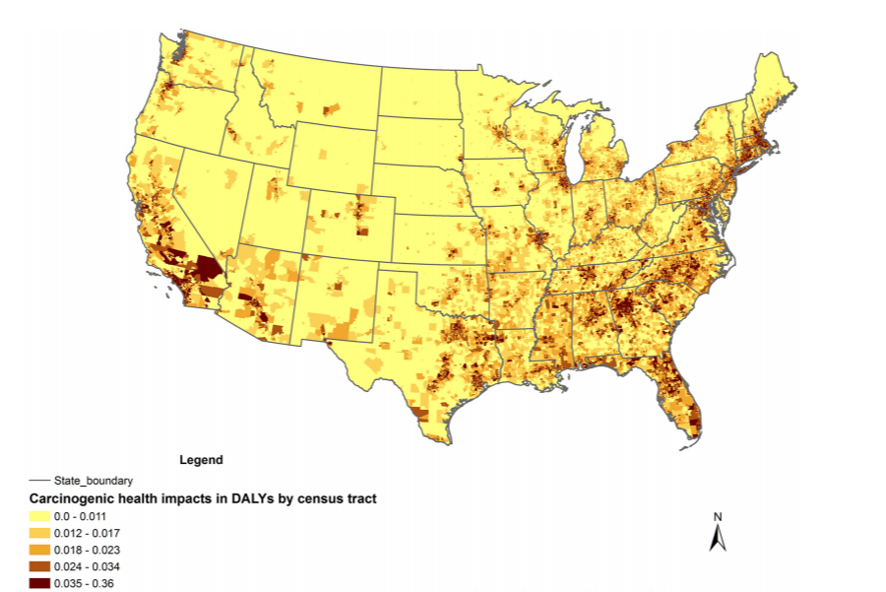
Cumulative carcinogenic health impacts in Disability-Adjusted Life Years per year by census tract caused by inhaling the top 10 carcinogenic air toxics

Slide 23
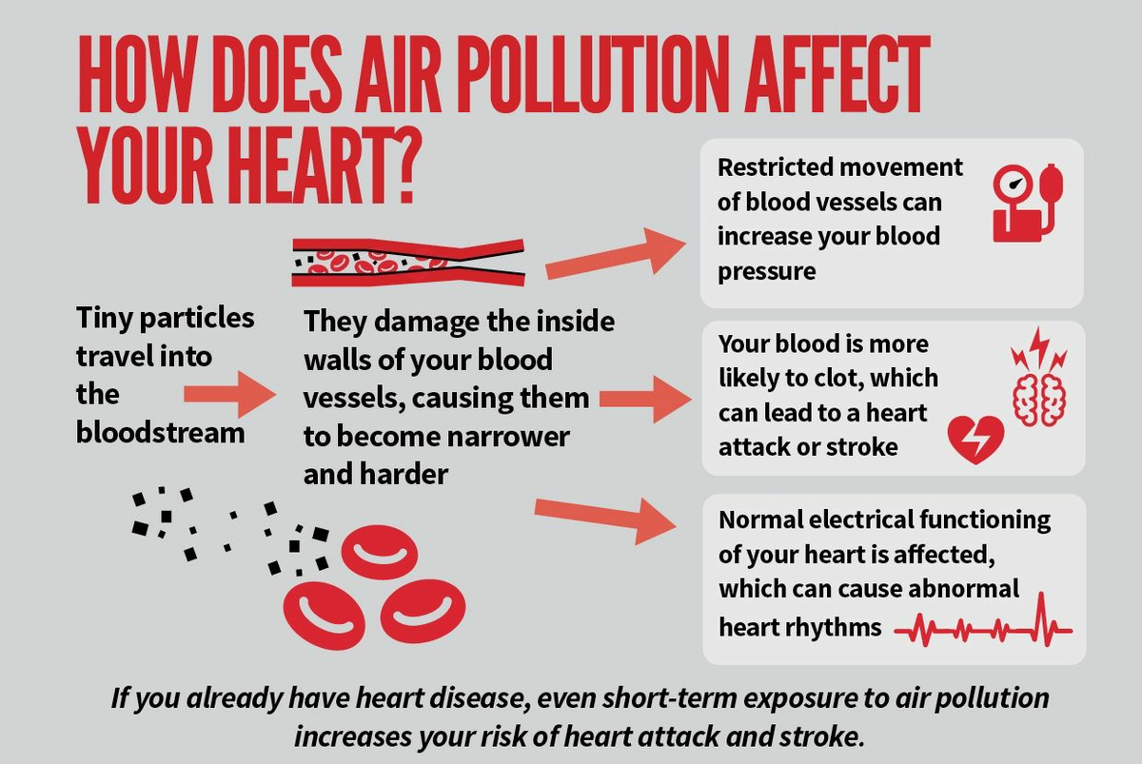
American Heart Association
Notes:
Heart disease – check slides

Slide 24

How can I tell when the air is unhealthy?
Can you see air pollution? Invisible to the naked eye, ozone and fine particle pollution can cause asthma attacks
Notes:
Years ago it was really smoggy===which means poor air quality.
Today even with clear days---it could still be bad.
You cannot tell just by looking…..now I have a tool for you. This tool will alert you to poor outdoor air quality days.

Slide 25


Air Quality Alerts
Sign up with the following resources: www.airnow.gov to receive alerts on your smartphone through an App. www.airqualitypartnership.org to receive alerts by email or text.

Slide 26
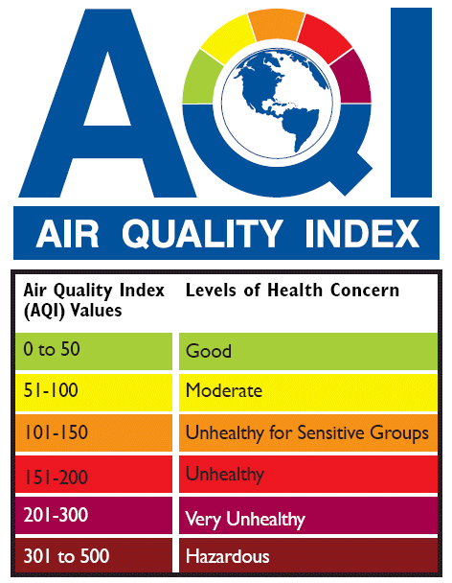
How do we use this information?
We breathe faster when we exercise, like playing sports outside and end up breathing more air.
Orange or above--- everyone should avoid outdoor exercise in the afternoon.

Slide 27

Talk about it
You can help friends and family by talking about air quality
Tell other people about this free information source and how to sign up! www.airqualitypartnership.org
www.airnow.gov
Notes:
11-13, 24-27 next pres.

Slide 28
Air Quality in Indoor Environments
External sources
Building structure
Interior furnishings
Mechanical systems
Occupants

Slide 29
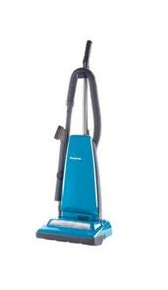
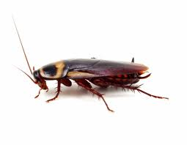
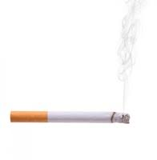
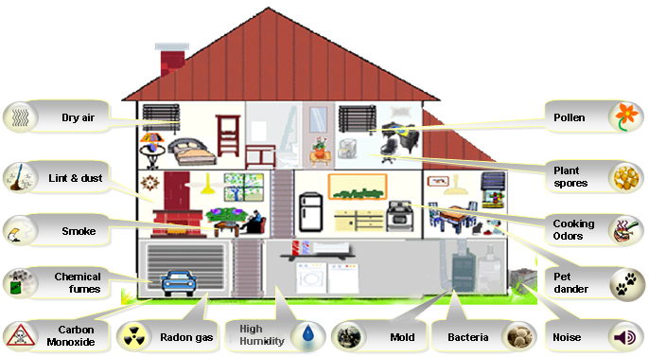
Exposures at HOME

Slide 30
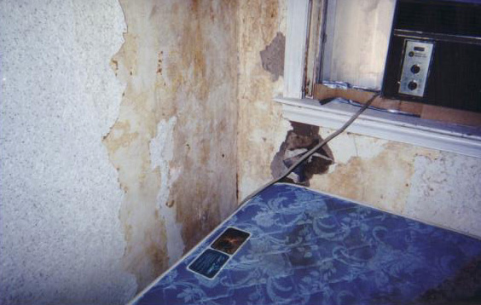
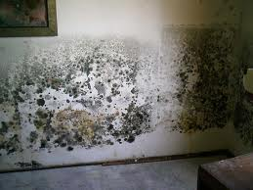
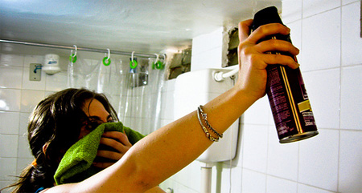
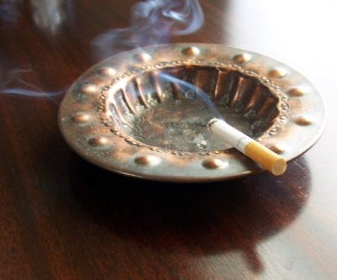
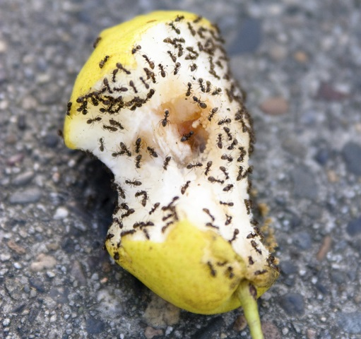
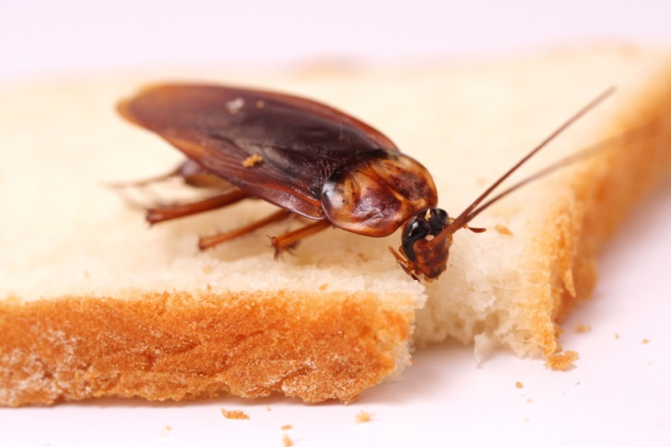
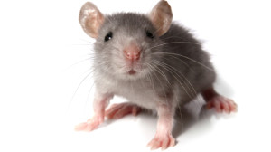
Asthma Triggers at Home

Slide 31
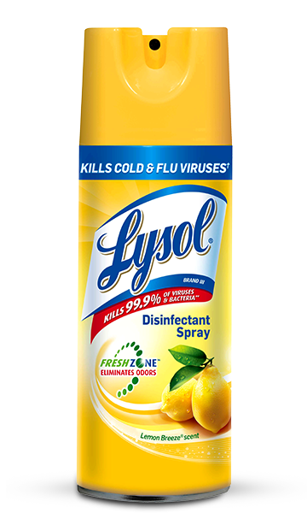



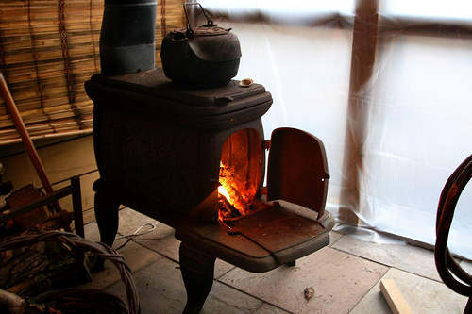
Other Asthma Triggers at Home
Sprays have aerosols that go deep in the lung
Contain volatile organic chemicals that can be irritants
Particulates and toxic chemicals
Notes:
28-31 move to indoor air presentation

Slide 32
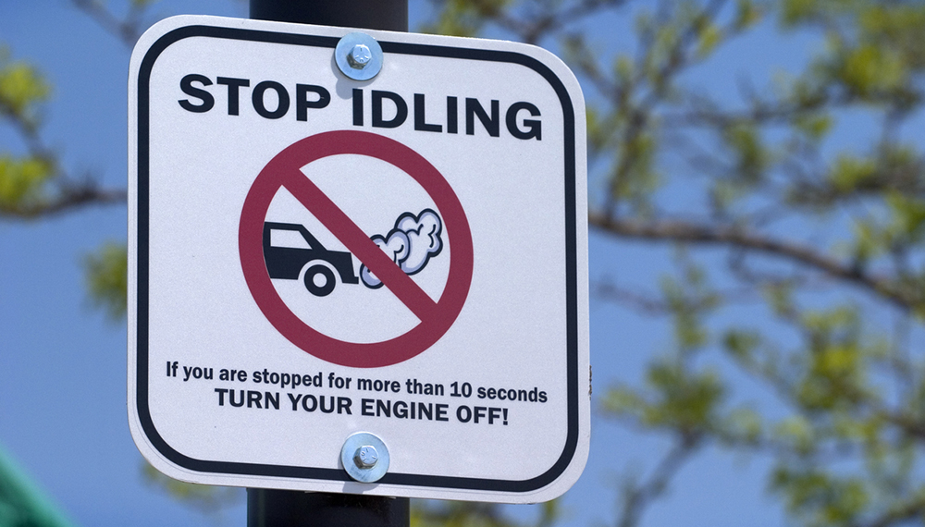
Activity: How much gas is used when you idle?

Slide 33
How to calculate how much gasoline is used by an idling vehicle
Different sized engines consume gas at different rates when they are idling.
Vehicle Type (Engine Size in Liters) | Idling Fuel Use (with no car accessories, like AC or radio, running)
Light-duty gasoline-fueled vehicles (passenger vehicles) | 0.0053 gal/min (or 0.32 gal/hr)
Light-duty gasoline-fueled trucks (pick-up trucks, SUVs, minivans) | 0.0118 gal/min (or 0.71 gal/hr)
To calculate how much gasoline is used by an idling vehicle:
(total minutes idling) x (gal/min) = Gallons of Gas

Slide 34
Example: Calculate the total amount of gas consumed while idling by a woman driving a sedan for one week.
Typical daily schedule:
7am: While driving her child to school, she picks up another student at their house. She idles for 9 minutes outside their house.
7:15am: While waiting in the drop-off line at school, she idles for 12 minutes.
12pm: She leaves work to grab some lunch. She leaves her car running for 8 minutes while she runs into a convenience store.
3:30pm: While waiting in the pick-up line at school, she idles for 14 minutes.

Slide 35
Example: Calculate the total amount of gas consumed while idling by a woman driving a sedan for one week.
Sedan: light-duty gasoline-fueled vehicle (0.0053 gal/min)
(total minutes idling) x (gal/min) = Gallons of Gas
Typical daily schedule:
7am: 9 minutes
7:15am: 12 minutes
12pm: 8 minutes
3:30pm: 14 minutes
43 minutes x 0.0053 gal/min = 0.2279 gal/day

Slide 36
Example: Calculate the total amount of gas consumed while idling by a woman driving a sedan for one week.
0.2279 gal/day x 180 school days/year = 41.022 gals/year
41.022 gals/year x $3.719/gallon = $152.56 spent on gas idling

Slide 37
This week, think about how much time you spend idling.

