Slide 1
Georgia Air Pollution
10/11/2023
Adrian Wood, MPH
Coordinator, Community Engagement Core

Slide 2
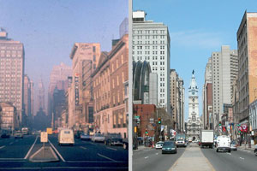
What is Air Pollution?

Slide 3
What is Air Pollution?
Substances in the atmosphere that damage the environment, human health or quality of life

Slide 4
Sources of Poor Outdoor Air Quality in Philadelphia?

Slide 5
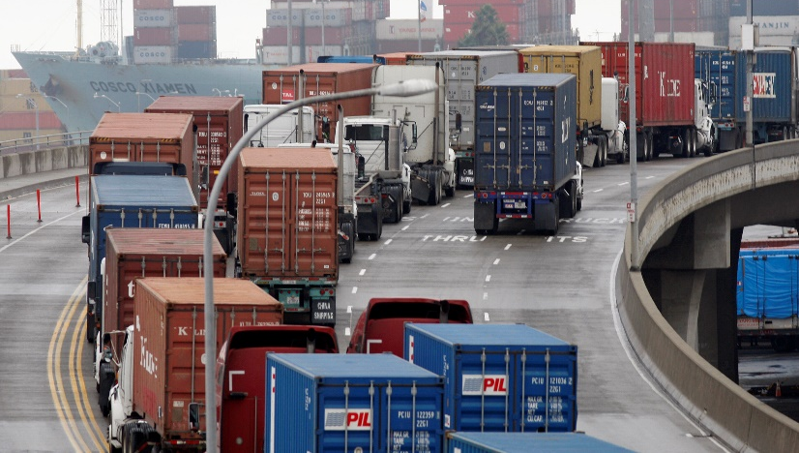
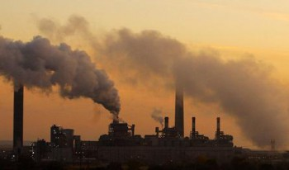
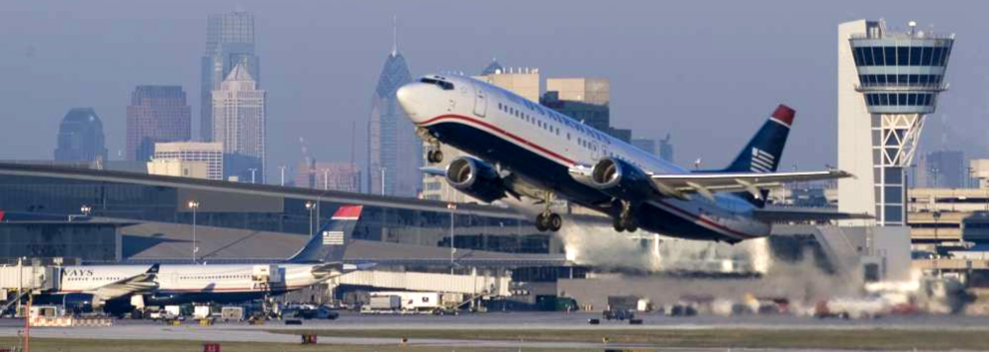
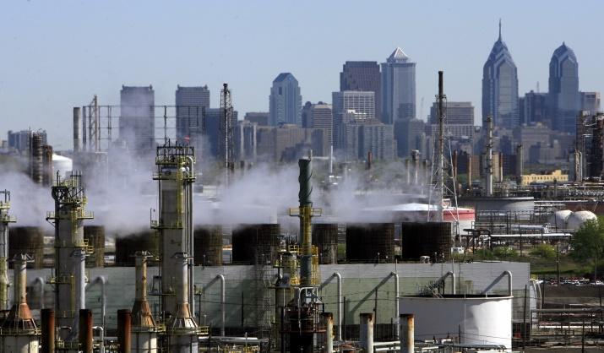
Sources of Poor Outdoor Air Quality
Auto Exhaust
Coal-Fired Power Plants
Airports
Oil Refineries

Slide 6
How Does Poor Outdoor Air Quality Affect Your Health?

Slide 7
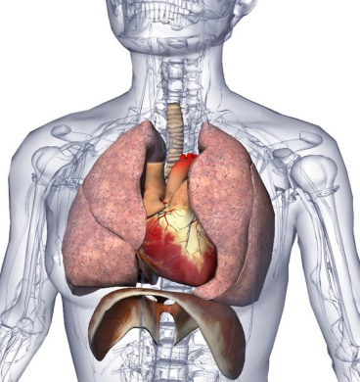
Sensitive Groups
Groups especially sensitive to pollution include:
Children
Elderly
People with heart and lung disease
People who work outside during the Summer.

Slide 8
Combined Effects of Environmental Exposure
Asthma
Nitrogen oxides
Ozone
Particulates (PM 2.5)
Sulfur dioxide
Pollen
Mold
Cockroach allergens
Smoking
Hazardous Air Pollutants
Aldehydes
Anhydrides
Isocyanates
Metals
Chlorine
Styrene

Slide 9
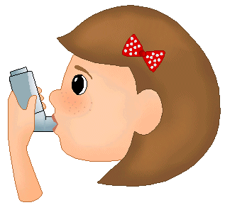
Asthma and Breathing Problems
Smoggy Environment
Missed Outdoor Exercise
Missed School Days
Notes:
A smoggy environment creates consequences. Poor outdoor air quality increases asthma and breathing problems, especially in children. Children in your school are more likely to miss school and outdoor play.

Slide 10
Breathing Problems
Poor outdoor air quality causes asthma attacks
Philadelphia has 2-3 times as much asthma as the rest of Pennsylvania.
Asthma is the third-ranking cause of hospitalization among children
Notes:
Possible questions from audience: **** What defines a child. Under 18? A 5 year old may react differently from a 17 year old.**** Why is Philly asthma so high?**** Humidity contributes to asthma, but is it considered a type of poor outdoor air quality? Philadelphia has an exceptionally high instance of childhood asthma

Slide 11
Missed School Days
Students dealing with asthma and breathing problems are more likely to miss school.
Missed social interactions
Lowered self esteem
Missed school work---hard to make up
10.5 million school days are missed every year due to asthma.
Notes:
Teachers need to make up lessons for sick children. This creates more work.

Slide 12
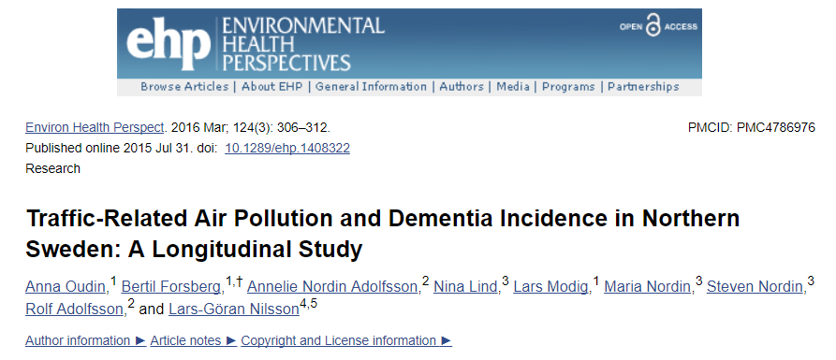
Chronic air pollution exposure decreases cognitive function
Chronic air pollution exposure may increase risk for developing Alzheimer’s and other dementia

Slide 13
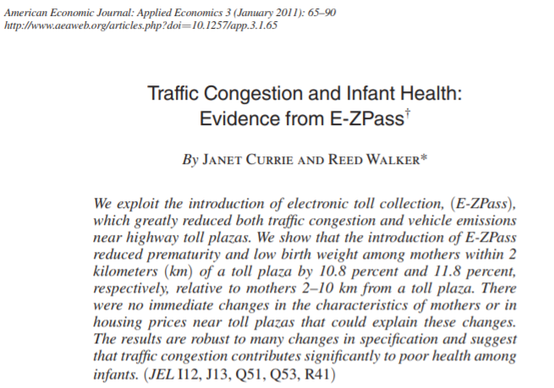
Prematurity and Low Infant Birth Weight
Introduction of EZ PASS led to 10.8% reduction of prematurity and 11.8% reduction of low birth weight within 2 km of the toll plaza
Decreased CO and NO_{x}
Interventions matter to health

Slide 14
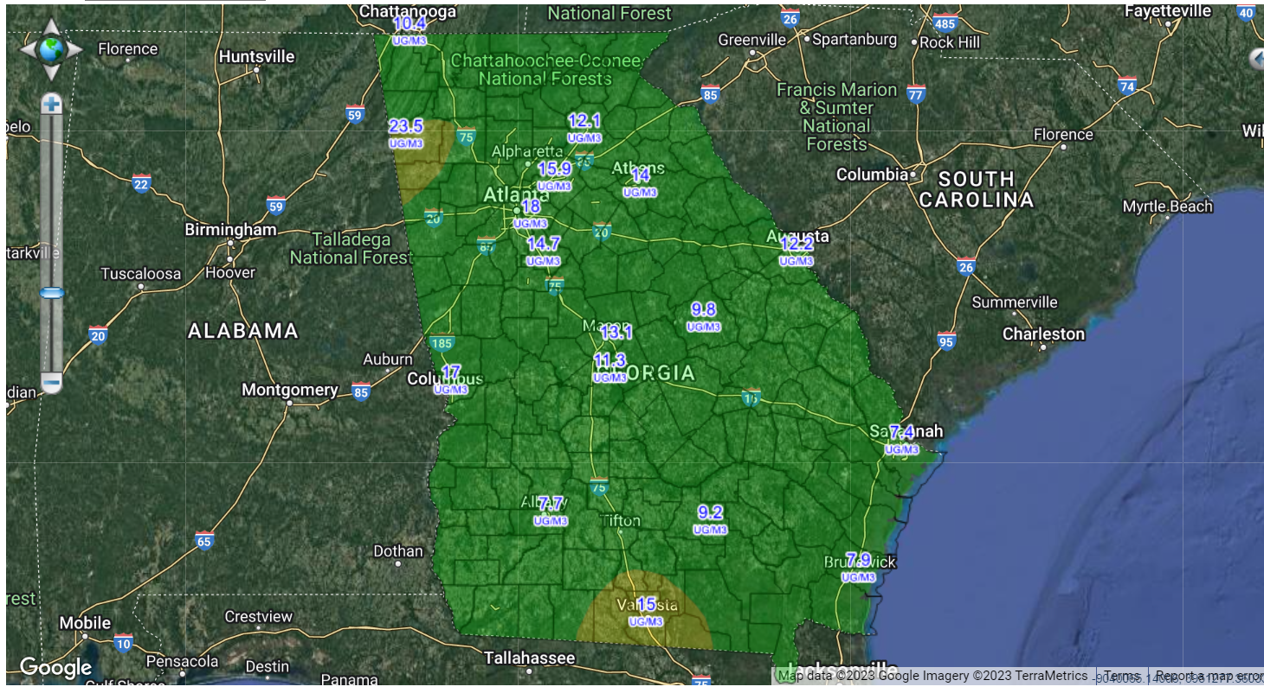
Air Pollution in Georgia

Slide 15
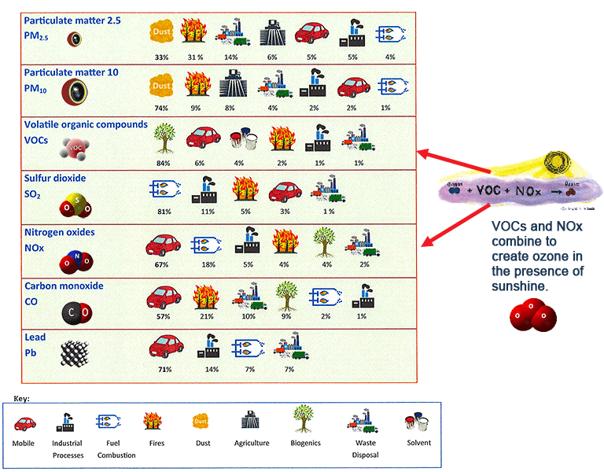
Primary Sources of Air Pollution in Georgia

Slide 16
Primary Sources of Air Pollution in Georgia

Slide 17
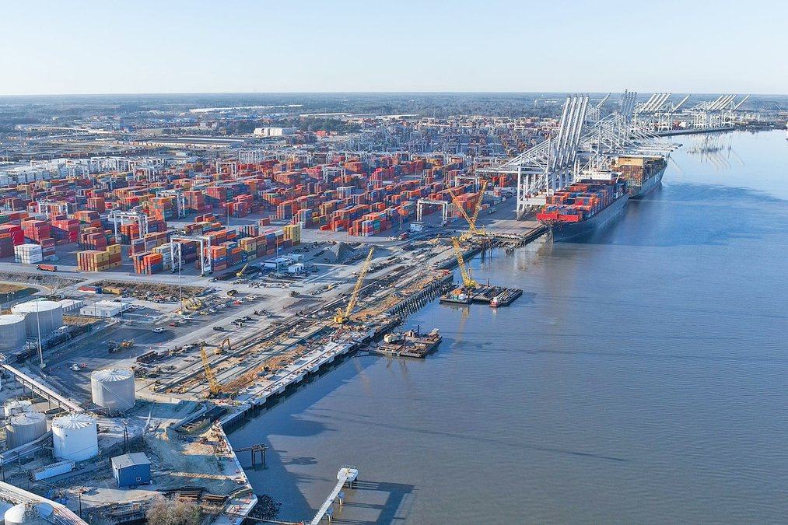
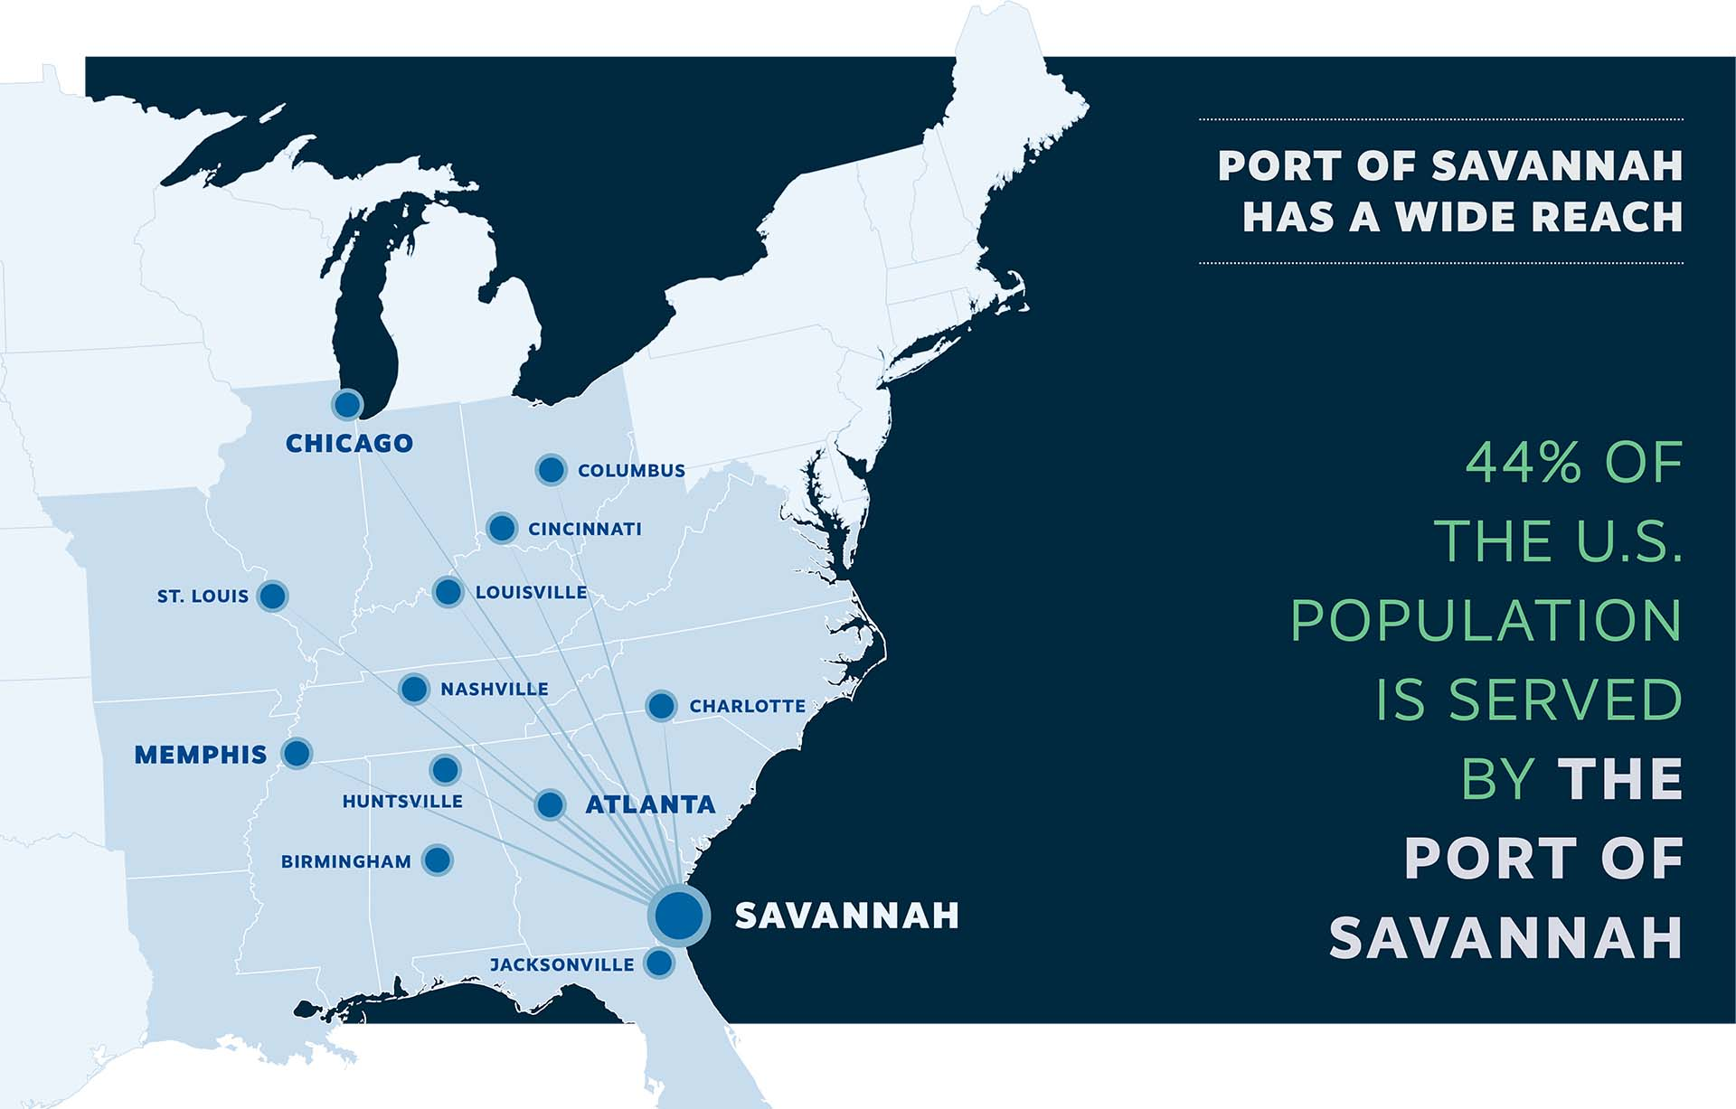
Port of Savannah
The Port of Savannah is one of the largest and busiest seaports in the United States.

Slide 18
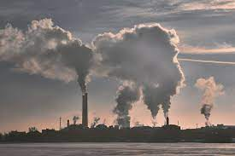
Air Pollution from Ships and Ports
Ship emissions
Cargo handling equipment
Vessel traffic
Fuel storage and transfer
Dust

Slide 19
Air Pollution from Ships and Ports
Ship emissions
Cargo handling equipment
Vessel traffic
Fuel storage and transfer
Dust
Ship Emissions: Ships at seaports typically rely on diesel engines, which emit pollutants such as sulfur dioxide (SO2), nitrogen oxides (NOx), particulate matter (PM), and volatile organic compounds (VOCs). These emissions can contribute to poor air quality in and around the port area.

Slide 20
Air Pollution from Ships and Ports
Ship emissions
Cargo handling equipment
Vessel traffic
Fuel storage and transfer
Dust
Cargo Handling Equipment: The use of heavy machinery, such as cranes, forklifts, and trucks, for cargo handling operations can generate emissions of diesel particulate matter and other pollutants.

Slide 21
Air Pollution from Ships and Ports
Ship emissions
Cargo handling equipment
Vessel traffic
Fuel storage and transfer
Dust
Vessel Traffic: Seaports with high levels of vessel traffic can experience increased emissions from idling ships waiting to load or unload cargo. This can lead to localized air quality issues.

Slide 22
Air Pollution from Ships and Ports
Ship emissions
Cargo handling equipment
Vessel traffic
Fuel storage and transfer
Dust
Fuel Storage and Transfer: Seaports often store large quantities of fuels for ships and other vehicles. The transfer and storage of fuels can lead to emissions of volatile organic compounds (VOCs) and other pollutants.

Slide 23
Air Pollution from Ships and Ports
Ship emissions
Cargo handling equipment
Vessel traffic
Fuel storage and transfer
Dust
Dust and Particulate Matter: Cargo handling, storage, and transportation activities at seaports can generate dust and particulate matter, leading to air quality concerns in the vicinity.

Slide 24
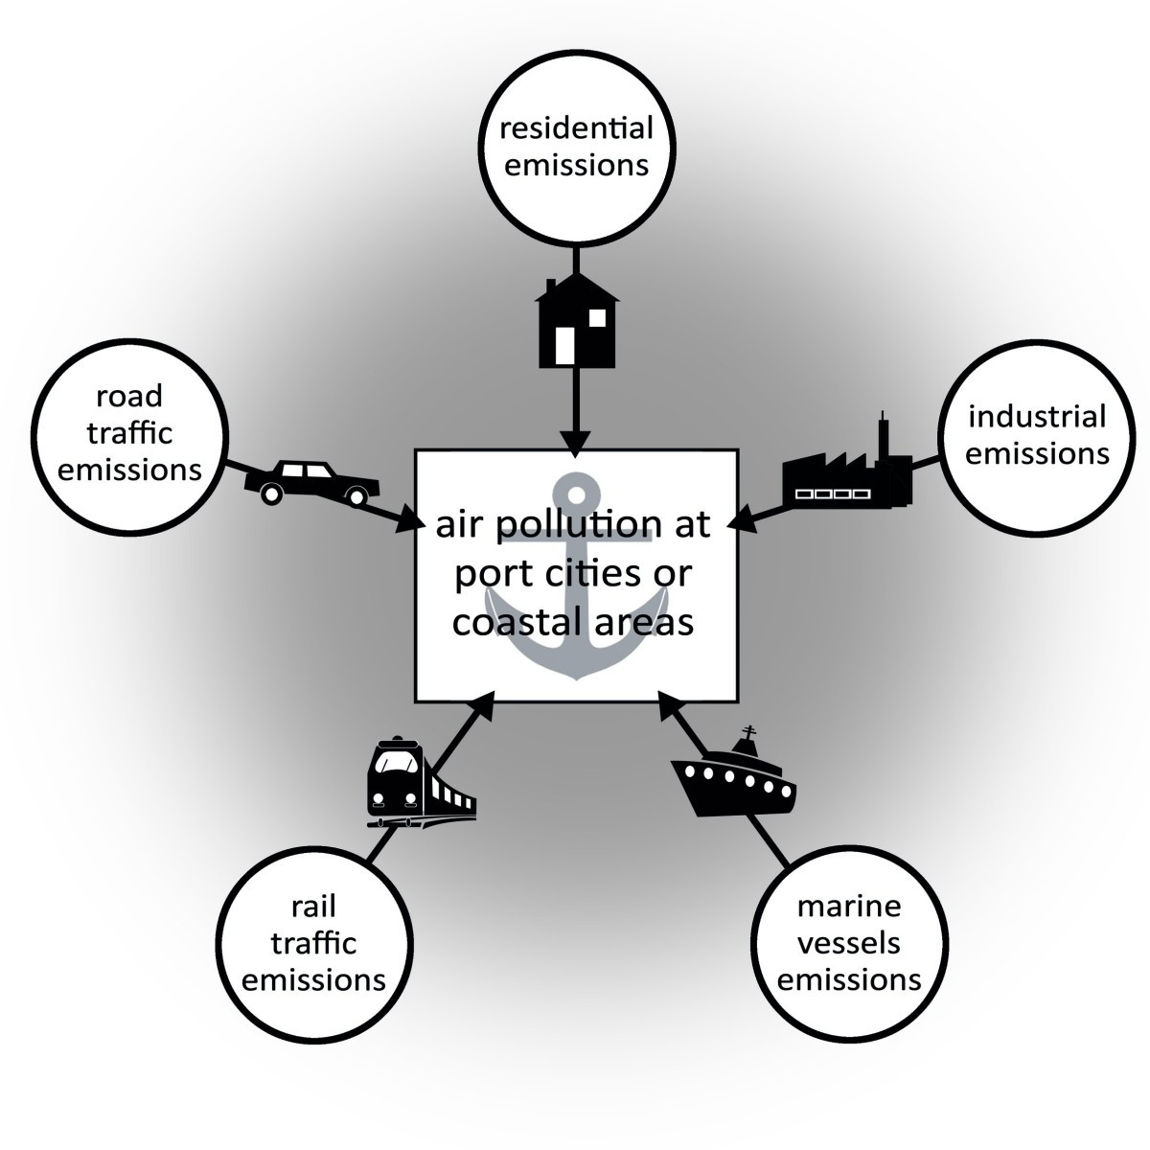
Air Pollution from Ships and Ports
Port-Adjacent Communities: The communities located near seaports may be at risk of exposure to higher levels of air pollutants. This can have adverse health effects, particularly for vulnerable populations such as children, the elderly, and individuals with pre-existing respiratory conditions.

Slide 25
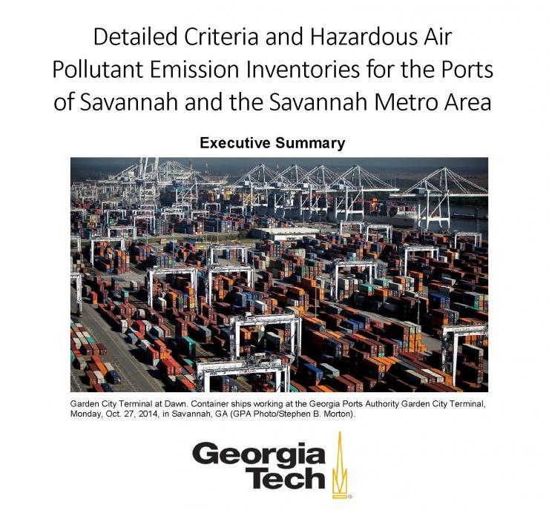
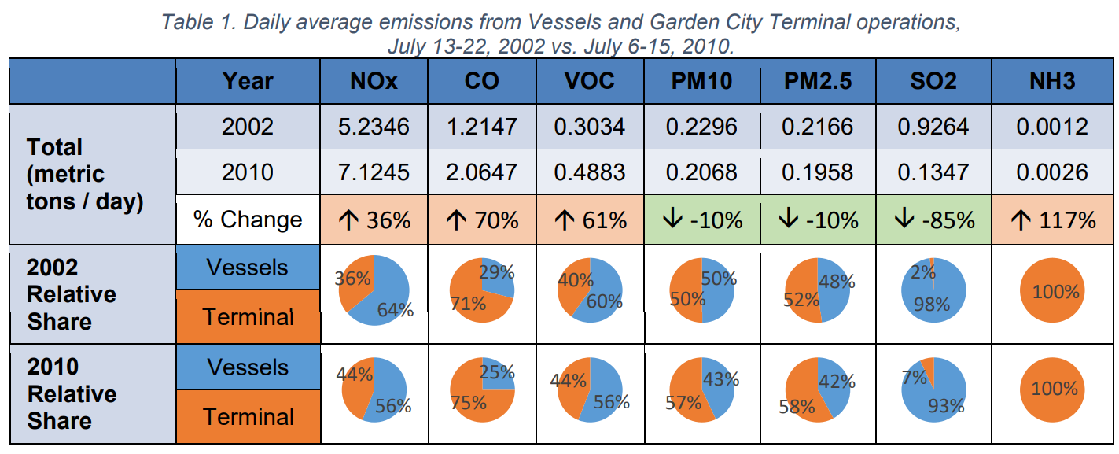
Air pollution study from Georgia Tech
Between 2002 and 2010:
Daily average emissions for ozone precursors (NOx and VOCs), carbon monoxide (CO), and ammonia (NH3) increased, while emissions of particulate matter (PM10 and PM2.5) and sulfur dioxide (SO2) decreased

Slide 26
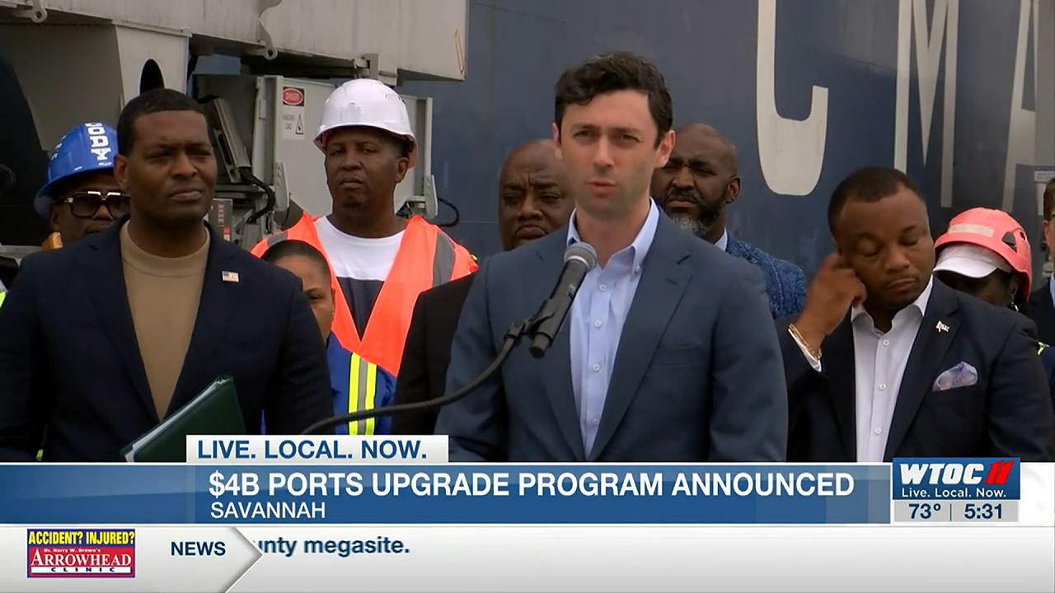
Port of Savannah
MAY 5, 2023
Environmental Protection Agency announced a nationwide effort to improve emissions and decrease pollution with more environmentally friendly equipment.
$4 billion will be invested in cleaner energy trucks at the ports in Savannah and around the nation.
This program will replace fossil fuel trucks and other equipment with those powered by alternate power - electricity, LP gas or others. The goal is to lower pollution emissions at ports like Savannah’s by 50 to 60 percent.

Slide 27
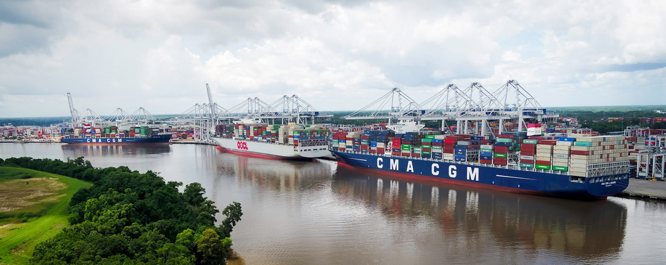
Port of Savannah
Several projects have been completed or are underway at the GPA’s terminals at the Port of Savannah. Projects have been funded by the GPA, the Federal Highway Administration (FHWA), the Georgia Department of Transportation (GDOT), and the EPA.
These projects have focused on making improvements in four primary areas:
Air quality and other environmental gains at the port and surrounding areas;
Time and cost saving efficiencies;
Congestion reduction in and around the port; and
Engagement and collaboration with surrounding communities

Slide 28
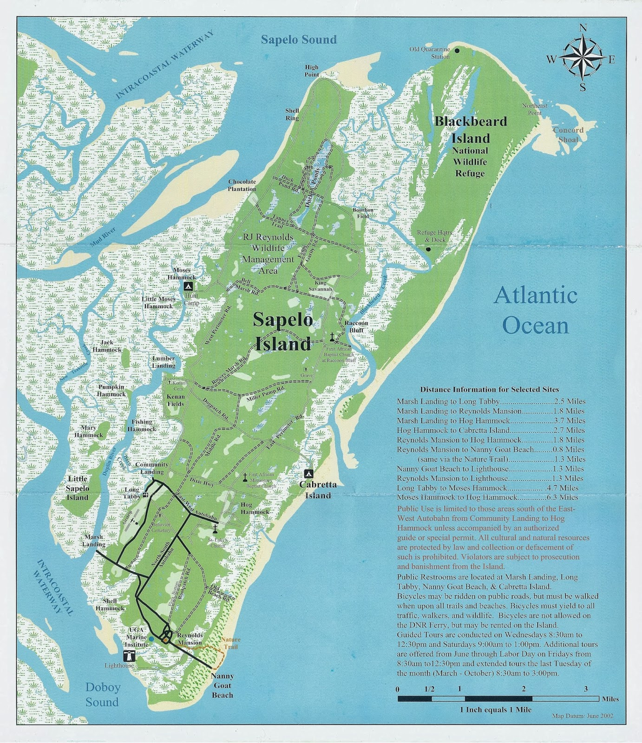
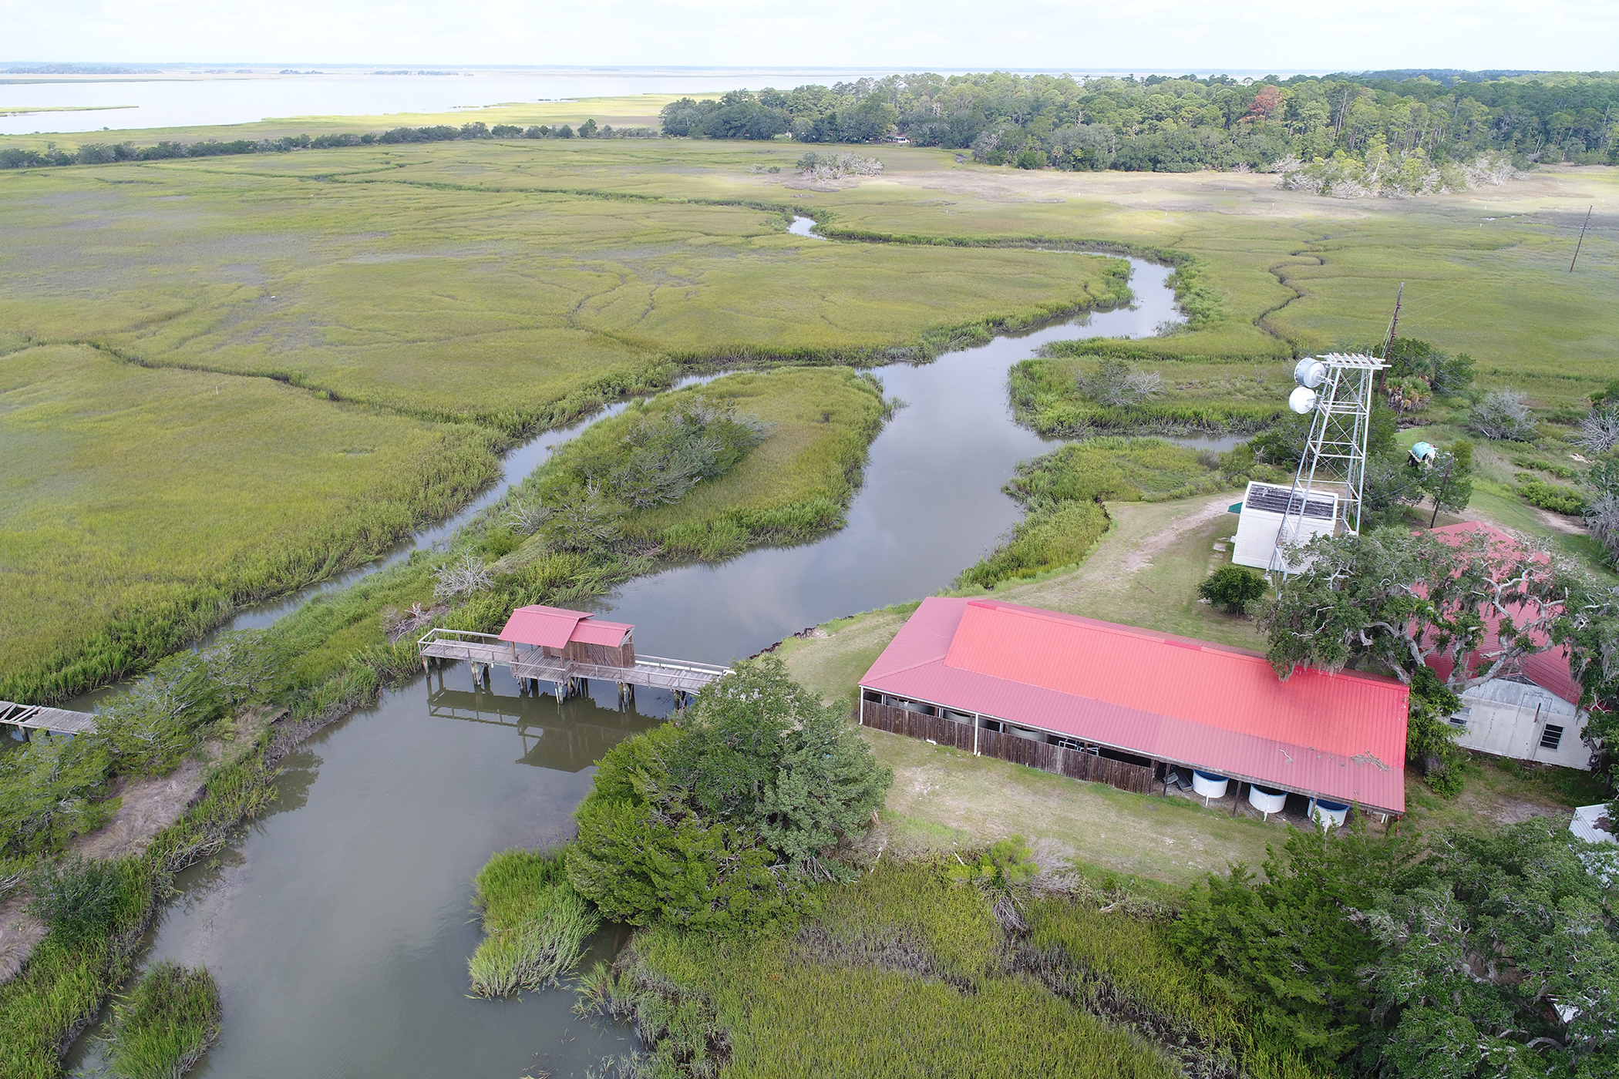
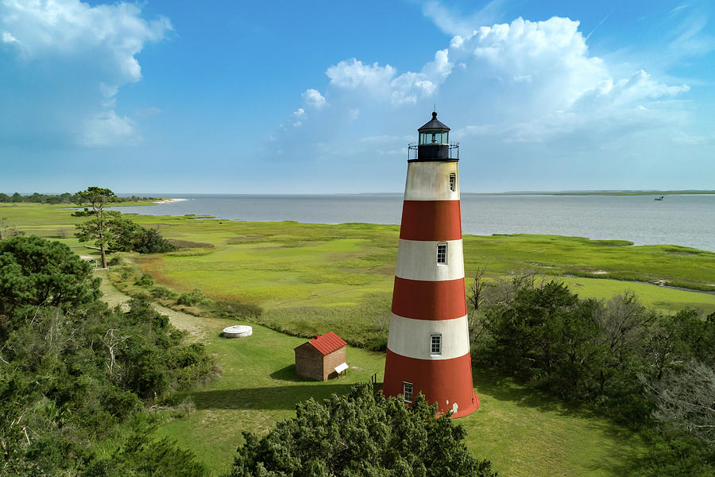
Sapelo Island, GA

Slide 29
Sapelo Island, GA
Sources of air pollution?

Slide 30
Sapelo Island, GA
Sources of air pollution?
Not many!
Dust
Sand
Natural disasters
Wildfires
Particulates from storms

Slide 31
Data collection through Atmotube personal air monitor

Slide 32
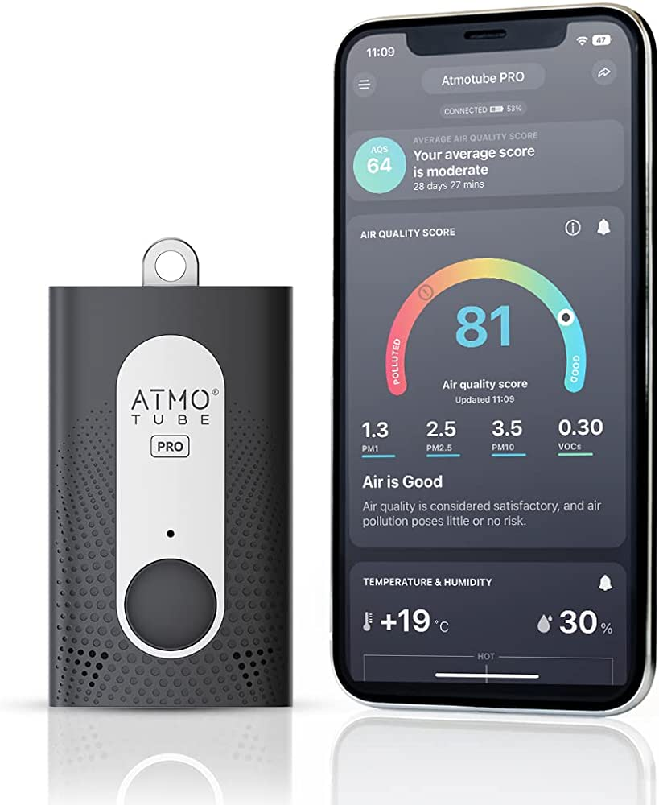
Atmotube
Monitors:
Temperature
Humidity
PM1
PM2.5
PM10
VOCs
Connects to Phone by Bluetooth to show real-time measurements
Keep device within 30ft of phone for Bluetooth connection
Data must be downloaded to a computer every 10 days

Slide 33
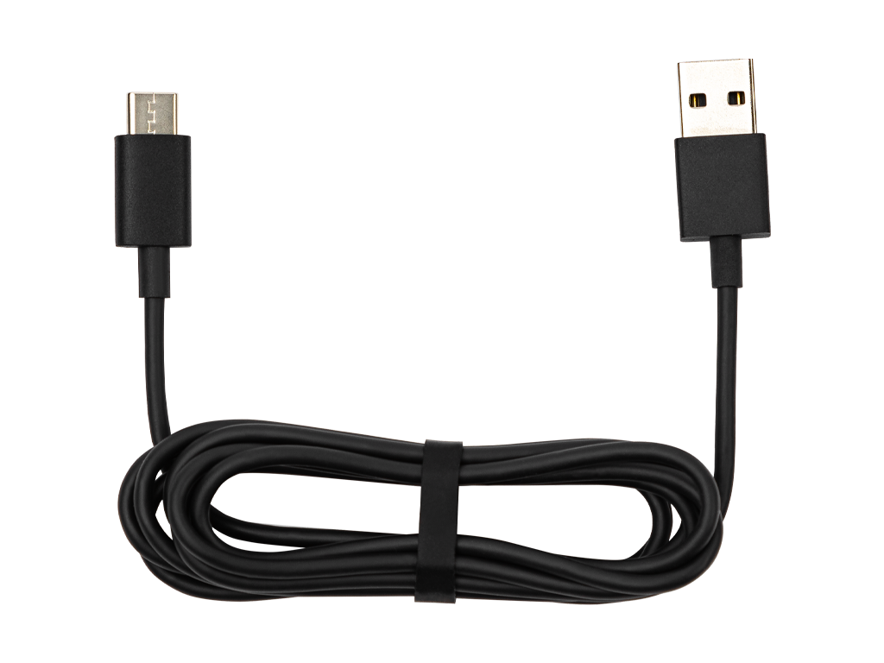
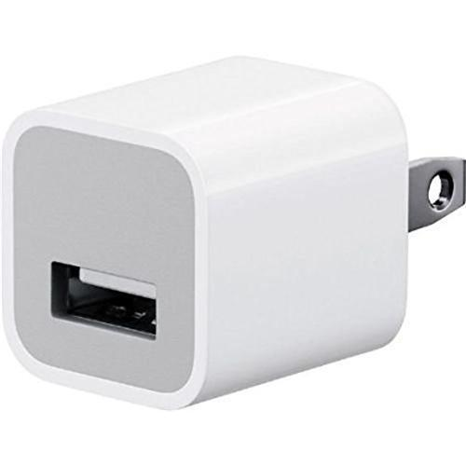
Atmotube
Battery lasts ~5 days
Recommend charging at night
Comes with a USB cord – you will need to bring a USB plug or charge it on a computer
Notes:
Ask Shirley about adapters? Bringing phones? Will they need an adapter?

Slide 34
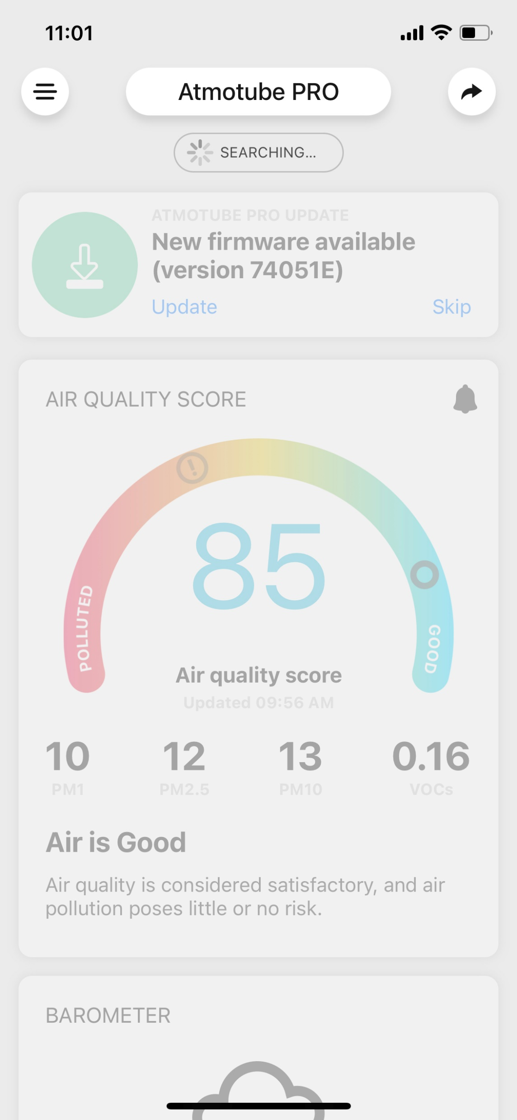
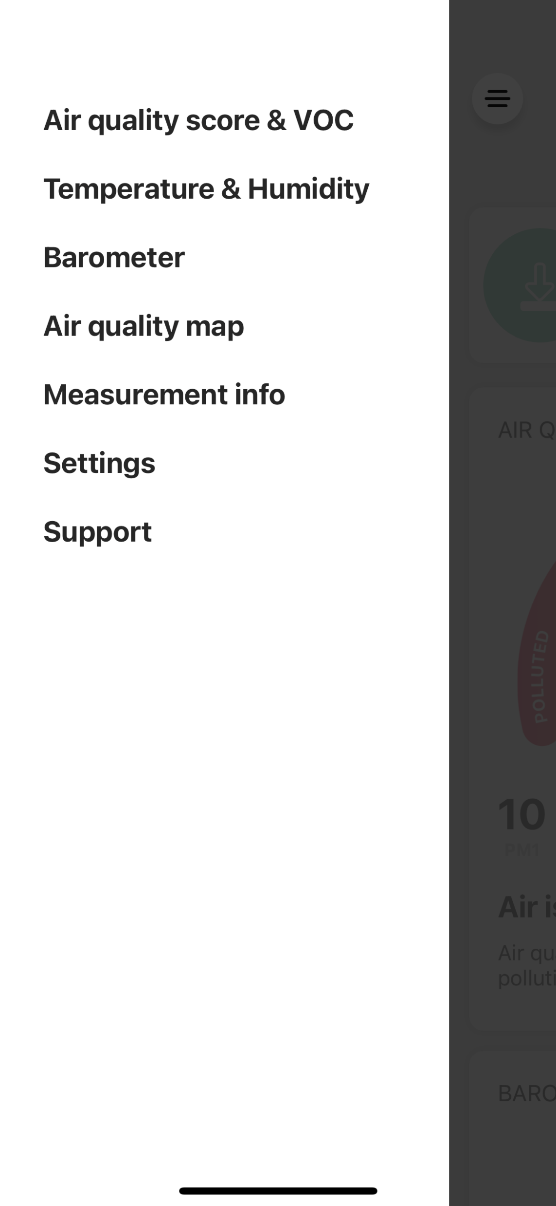
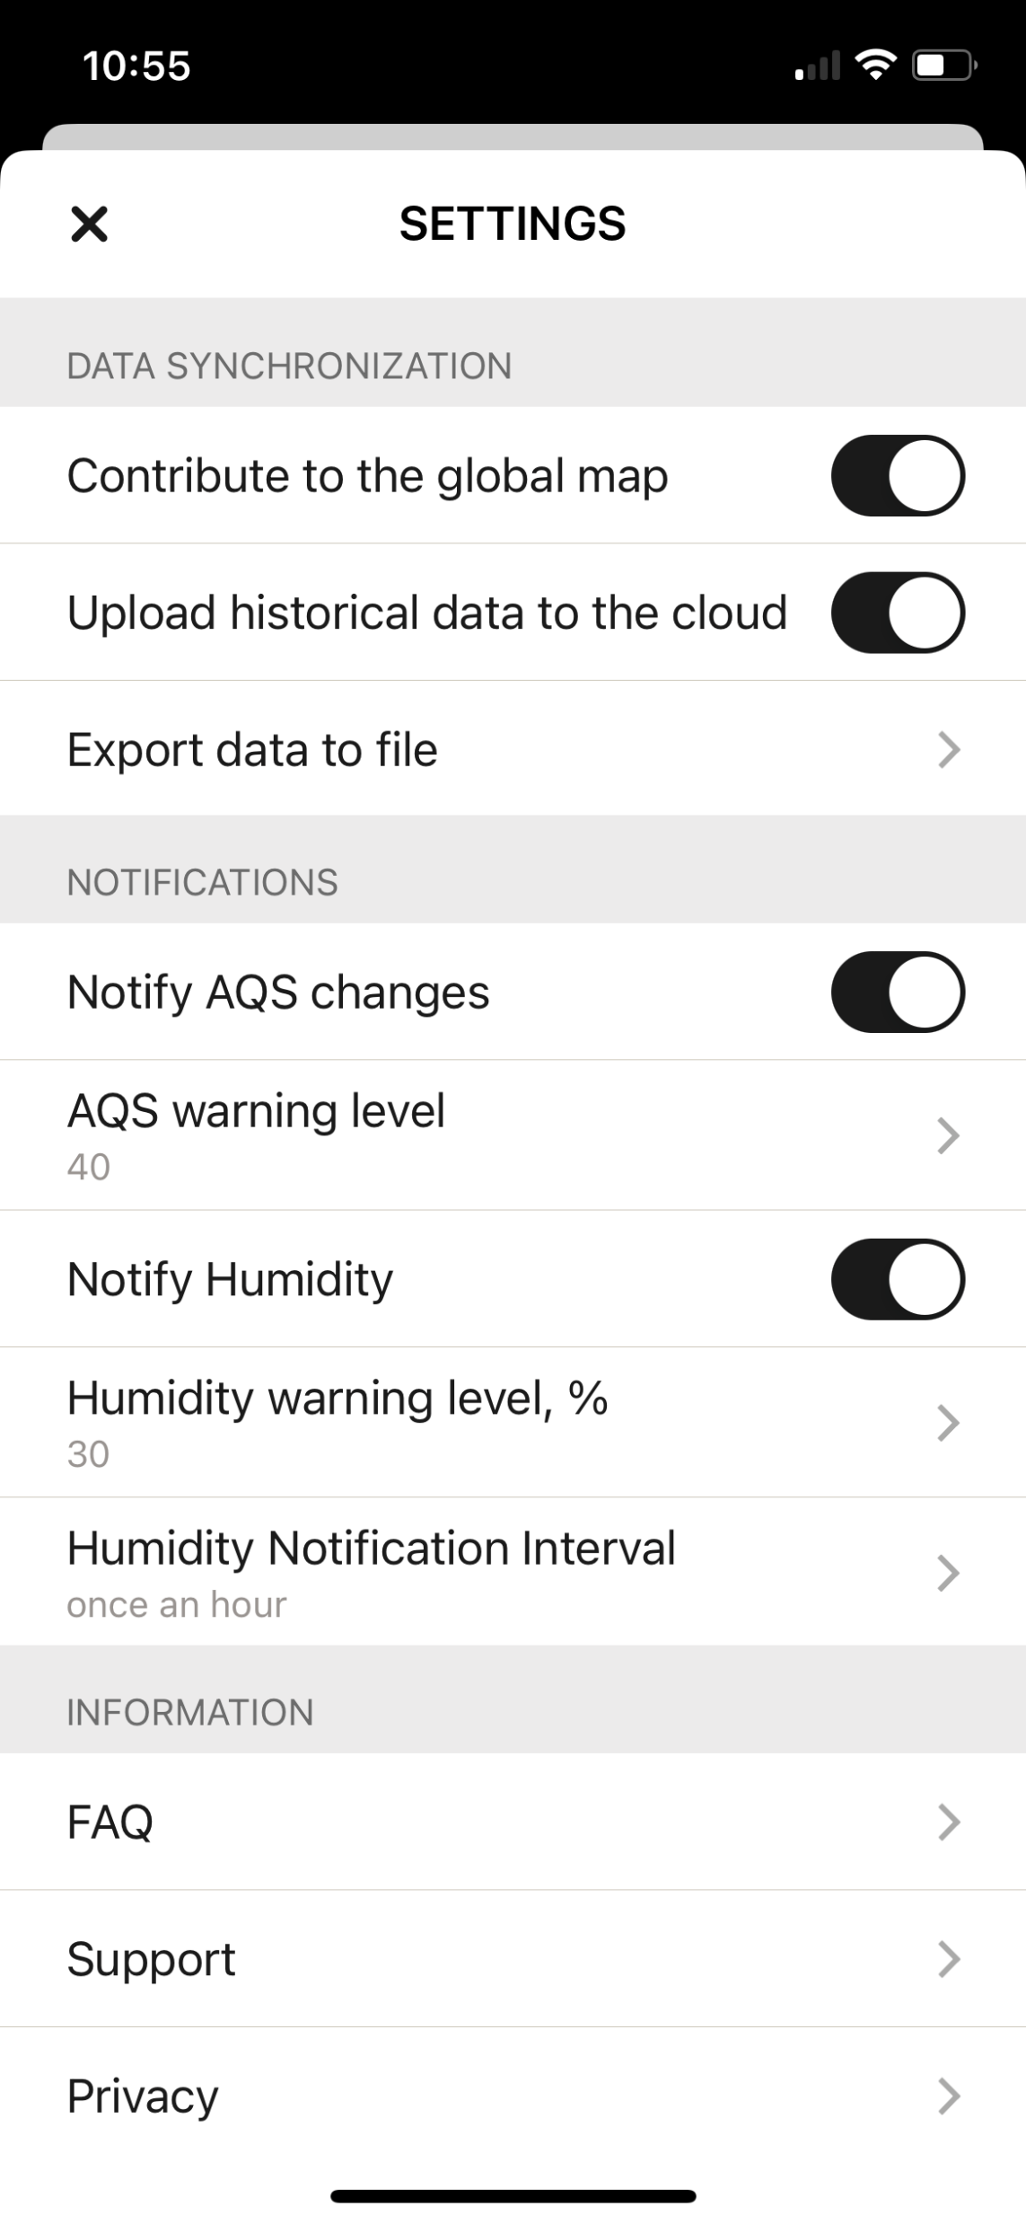
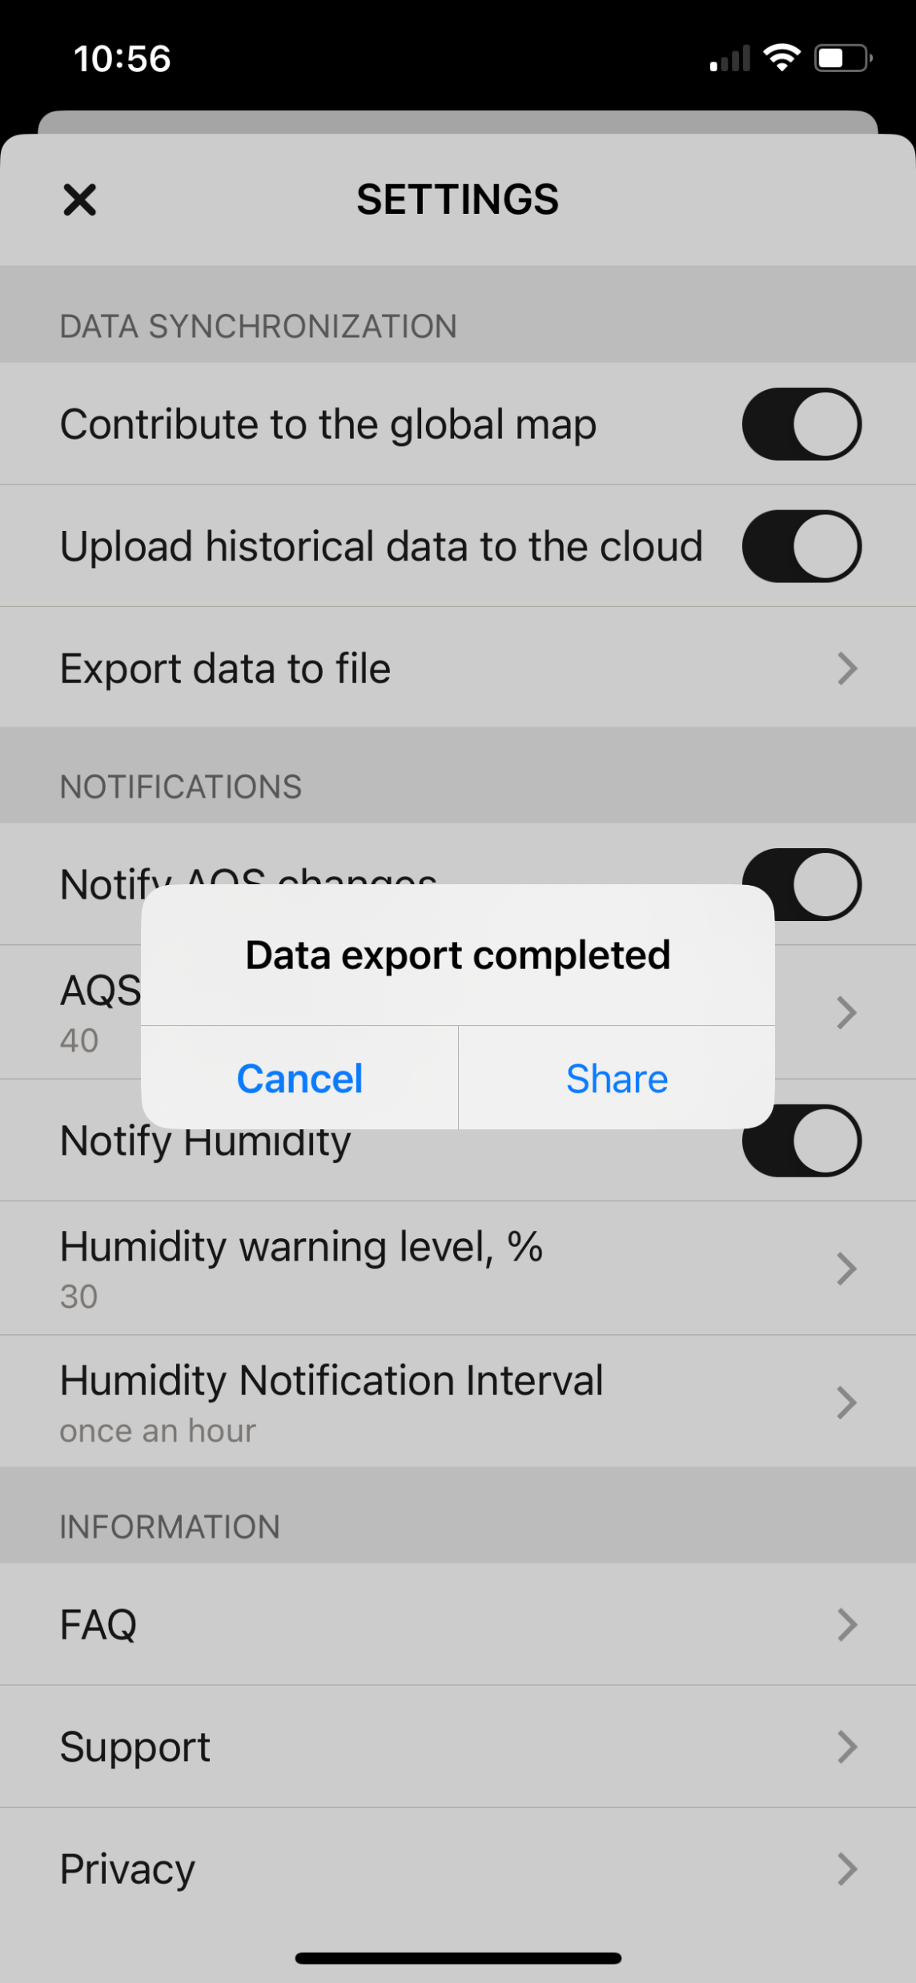
Atmotube – Downloading data
Data must be downloaded from the phone that was connected to the monitor through Bluetooth
To download data:
1. Open atmotube app and go to side panel
2. Open settings
3. Scroll down to export data to file
4. Click share data and send through email
Notes:
Ask Shirley about adapters? Bringing phones? Will they need an adapter?

Slide 35
Atmotube – Recording extra information
Record air pollution sources in writing or through pictures
Remember to include:
Date
Time
Location
Description of what you see
Smell?
Date | Time (start/end) | Indoor/ Outdoor | Location (ex: address, inside a home, along a road, etc.) | Description (What is happening?, ex: cooking, driving through traffic, etc).
Notes:
One person record one the hour, another person on half hour
Any anytime anything relevant is happening write it down
Labels monitors with books, monitor 1 and 2
Fill in some examples – diff kinds of descriptions
3 notebooks – 20 pages each notebook
Thursday

Slide 36
Air Pollution from Ships and Ports
Ship Emissions: Ships at seaports typically rely on diesel engines, which emit pollutants such as sulfur dioxide (SO2), nitrogen oxides (NOx), particulate matter (PM), and volatile organic compounds (VOCs). These emissions can contribute to poor air quality in and around the port area.
Cargo Handling Equipment: The use of heavy machinery, such as cranes, forklifts, and trucks, for cargo handling operations can generate emissions of diesel particulate matter and other pollutants.
Vessel Traffic: Seaports with high levels of vessel traffic can experience increased emissions from idling ships waiting to load or unload cargo. This can lead to localized air quality issues.
Fuel Storage and Transfer: Seaports often store large quantities of fuels for ships and other vehicles. The transfer and storage of fuels can lead to emissions of volatile organic compounds (VOCs) and other pollutants.
Cold Ironing Challenges: While the concept of "cold ironing" (shore power) involves providing electrical power to ships at berth, not all ports have this infrastructure. Ships may continue to use their engines while docked, contributing to air pollution.
Ballast Water Treatment: Ballast water treatment methods, which are essential for preventing the spread of invasive species, can involve the use of chemicals or other processes that may have environmental consequences, including air emissions.
Dust and Particulate Matter: Cargo handling, storage, and transportation activities at seaports can generate dust and particulate matter, leading to air quality concerns in the vicinity.

