Slide 1
Air Pollution in Ghana
5/17/2023
Marilyn V. Howarth, MD, FACOEM
Director, Community Engagement Core
Adrian Wood, MPH
Coordinator, Community Engagement Core

Slide 2
Air Pollution in Ghana
28,000 Ghanaians die prematurely every year as a result of air pollution, according to the World Health Organization (2020).
Air pollution is the second highest health risk factor for death and disability, after malnutrition.

Slide 3
Air Pollution in Ghana
In 2016, the annual mean level of PM_{2.5} in Accra was 31.1 μg/m³
3x higher than the recommended annual guideline of 10 μg/m³

Slide 4
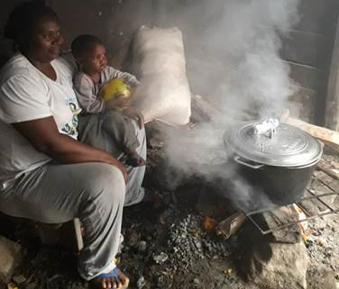
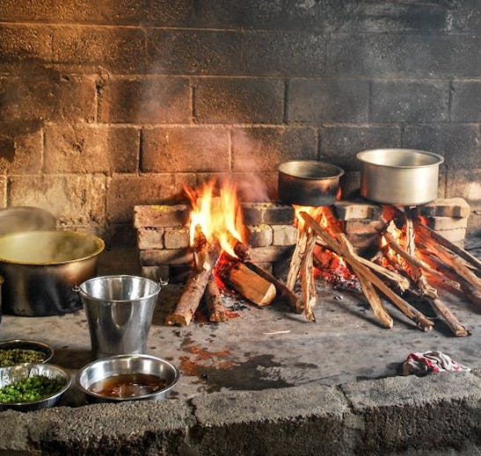
Household air pollution
In Ghana, about 70 percent of households cook by burning biomass including wood, charcoal, and crop residue in open fires.
The major emissions are PM_{2.5}, carbon monoxide and polycyclic aromatic hydrocarbons.

Slide 5
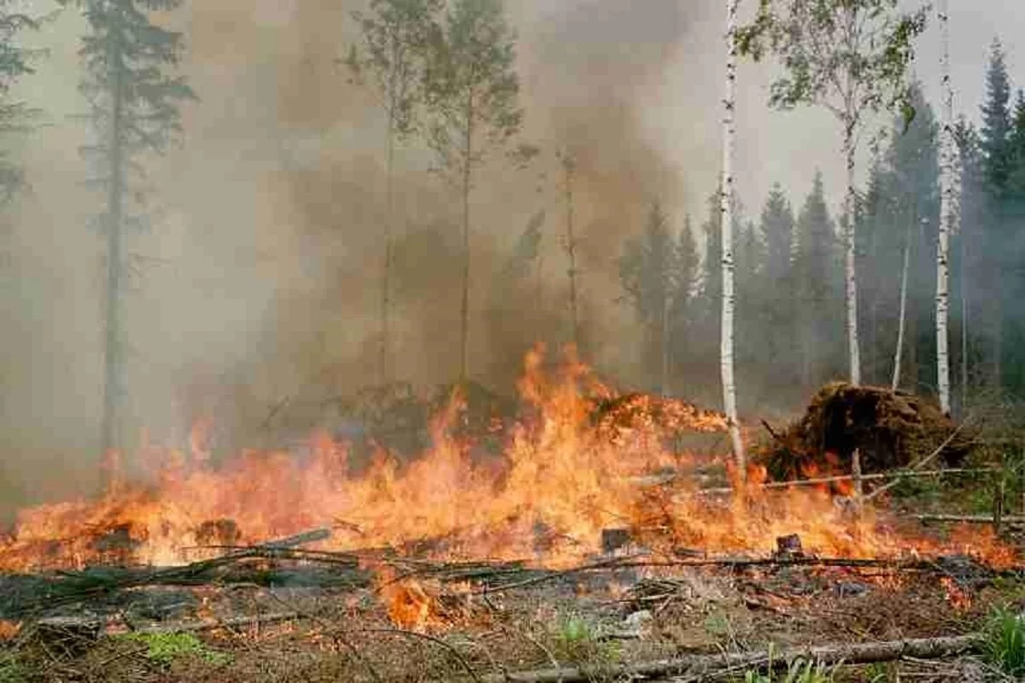
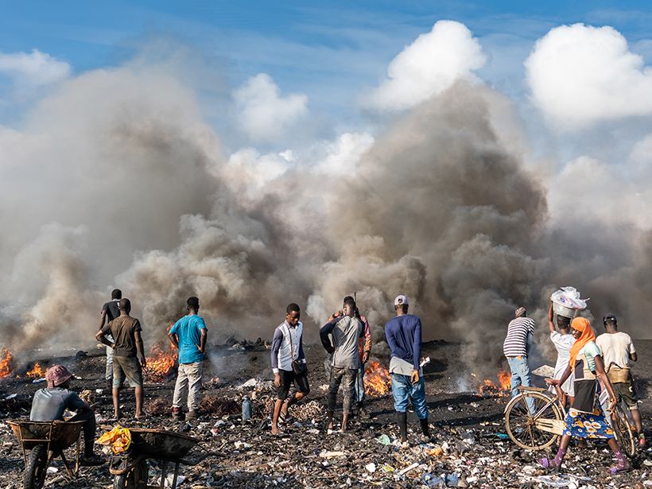
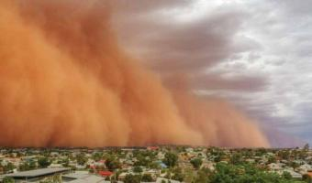
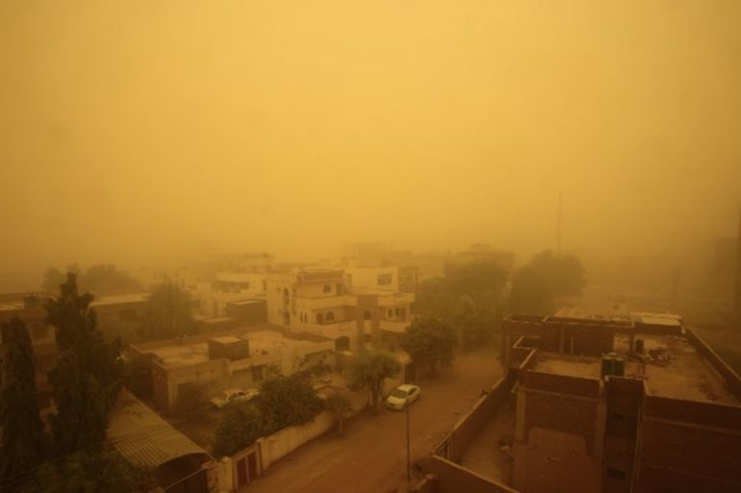
Sources of Poor Outdoor Air Quality in Ghana
Slash-and-burn methods of farming (rural)
Open waste burning
Accidental fires
Seasonal dust storms (Dry season: November – March)
Road transport (traffic in the city, dust in rural areas)
Industry
Energy generation

Slide 6
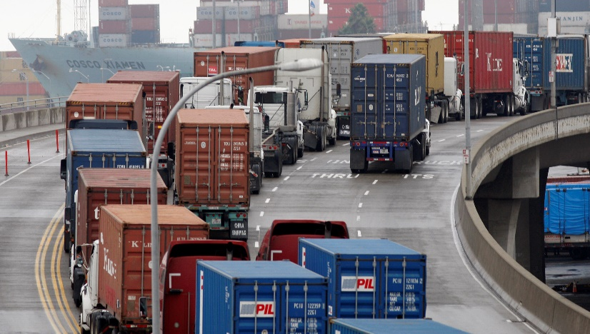
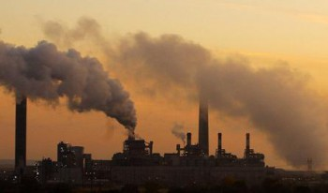
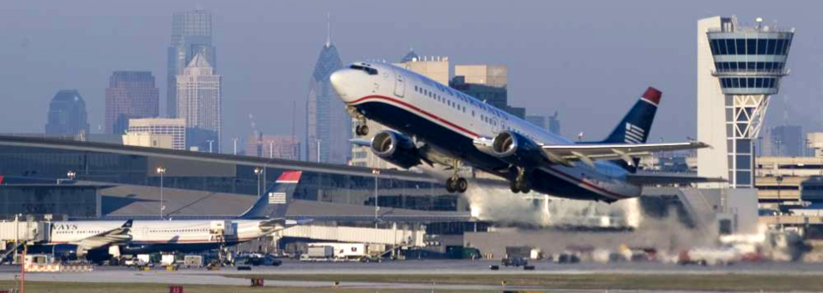
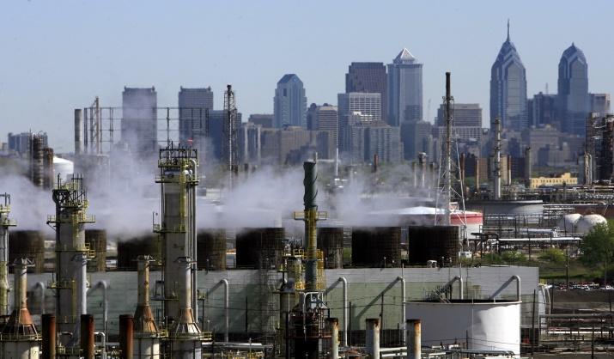
Reminder: Primary Sources of Poor Outdoor Air Quality in Philadelphia
Vehicle Exhaust
Coal-Fired Power Plants
Airports
Oil Refineries

Slide 7
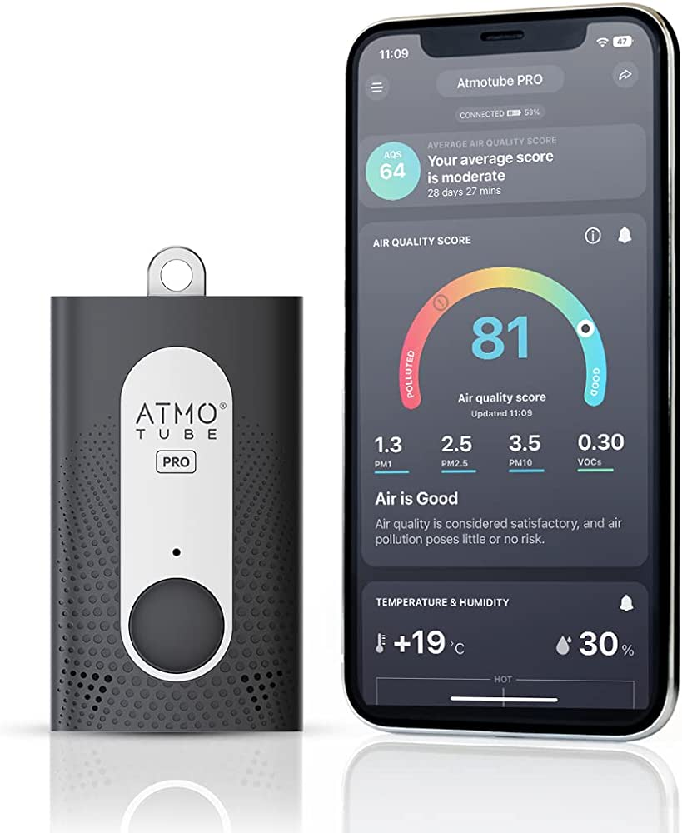
Atmotube
Monitors:
Temperature
Humidity
PM1
PM2.5
PM10
VOCs
Connects to Phone by Bluetooth to show real-time measurements
Keep device within 30ft of Phone for Bluetooth connection
Data must be downloaded to a computer every 10 days

Slide 8
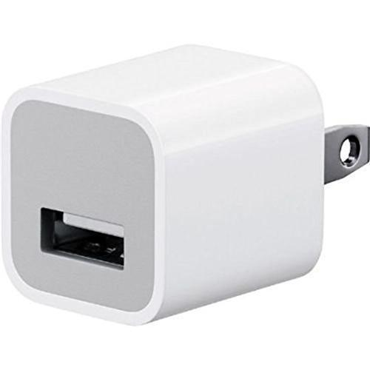
Atmotube
Battery lasts ~5 days
Recommend charging at night
Comes with a USB cord – you will need to bring a USB plug or charge it on a computer
Notes:
Ask Shirley about adapters? Bringing phones? Will they need an adapter?

Slide 9
Recording Data in Ghana
Date | Time (start/end) | Indoor/ Outdoor | Location (ex: address, inside a home, along a road, etc.) | Description (What is happening?, ex: cooking, driving through traffic, etc).
Notes:
One person record one the hour, another person on half hour
Any anytime anything relevant is happening write it down
Labels monitors with books, monitor 1 and 2
Fill in some examples – diff kinds of descriptions
3 notebooks – 20 pages each notebook
Thursday

Slide 10
Sources of Pollution
Source of Pollution | Particulates | VOCs
Indoor cooking | x
Slash-and-burn methods of farming (rural) | x
Open waste burning/Accidental fires | x | x
Seasonal dust storms (Dry season: November – March | x
Vehicle exhaust (city) | x | x
Industry | x | x
Energy generation | x
Sprayed pesticides or other chemicals |  | x
Air fresheners |  | x
Roadway dust (rural) | x

