Slide 1
Environmental Justice
February 27, 2022
Marilyn V. Howarth, MD, FACOEM
Director, Community Engagement Core
Adrian Wood, MPH
Coordinator, Community Engagement Core

Slide 2
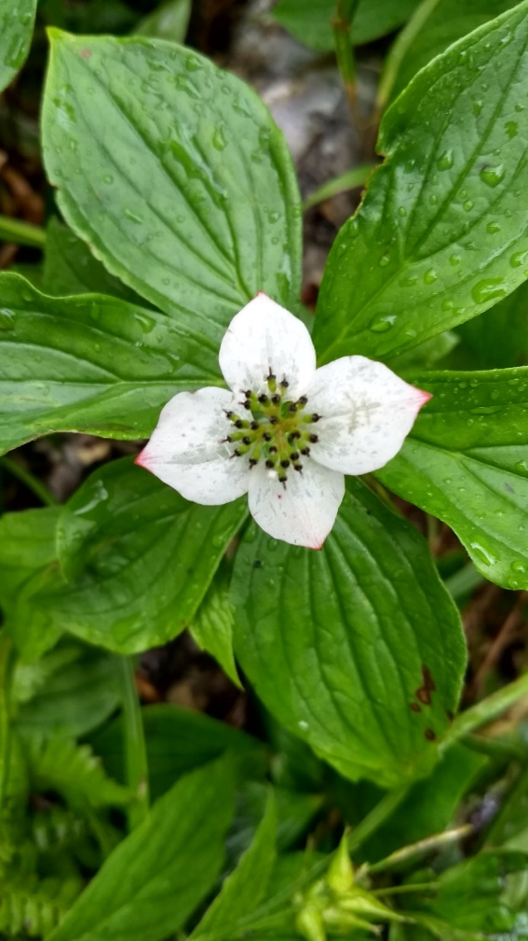
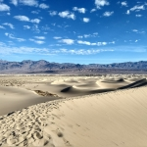
Does anyone control industry air pollution?
Yes
Clean Air Act
A law designed to protect human health and the environment from the effects of air pollution.
Cut ground-level ozone, a dangerous component of smog, by more than 25 percent since 1980;

Slide 3
2021 AMS Monitoring Network
Not all neighborhoods are monitored
Notes:
Add Imhotep

Slide 4
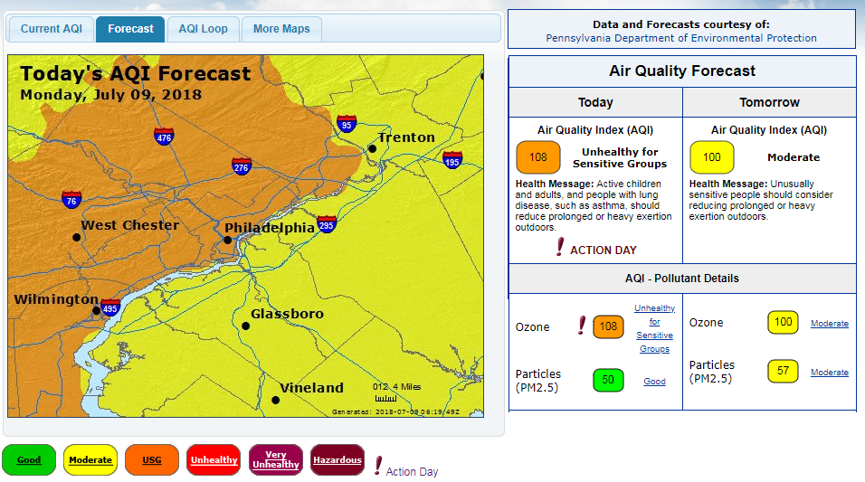
The EPA Tests The Air
www.airnow.gov
www.airqualitypartnership.org
Notes:
The EPA tests air all the time and has created a way to receive alerts. These sites measure ozone and fine particulate levels

Slide 5
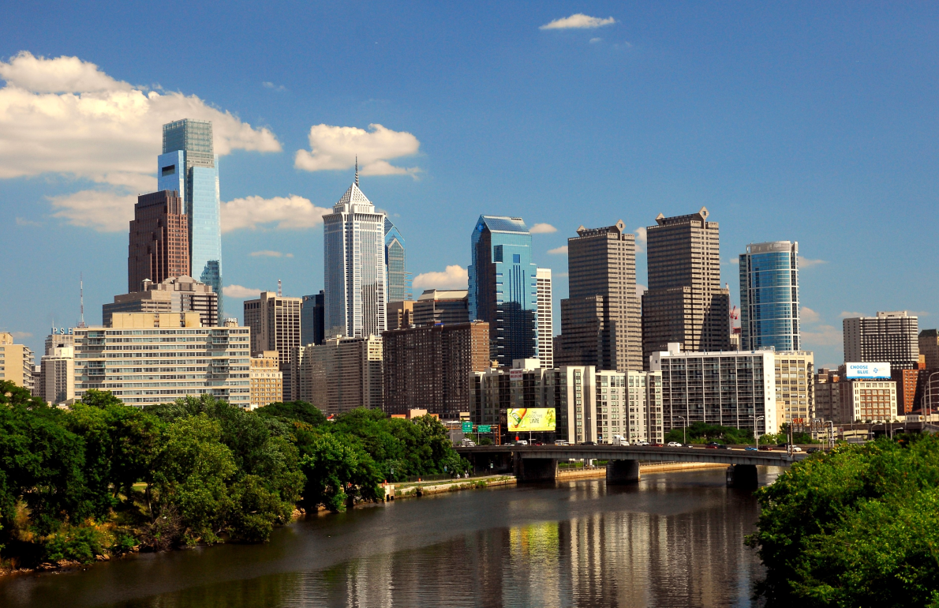
How can I tell when the air is unhealthy?
Can you see air pollution? Invisible to the naked eye, ozone and fine particle pollution can cause asthma attacks
Notes:
Years ago it was really smoggy===which means poor air quality.
Today even with clear days---it could still be bad.
You cannot tell just by looking…..now I have a tool for you. This tool will alert you to poor outdoor air quality days.

Slide 6
Air Quality Alerts
Sign up with the following resources: www.airnow.gov to receive alerts on your smartphone through an App. www.airqualitypartnership.org to receive alerts by email or text.

Slide 7
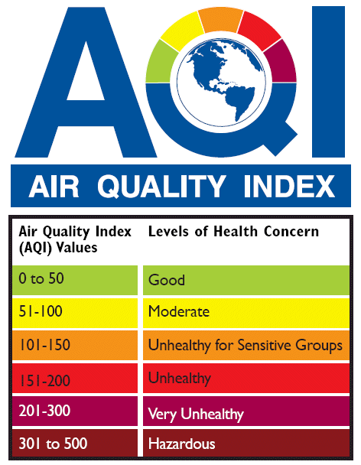
How do we use this information?
We breathe faster when we exercise, like playing sports outside and end up breathing more air.
Orange or above--- everyone should avoid outdoor exercise in the afternoon.

Slide 8
Environmental Justice
Notes:
2
Lead line

Slide 9
Robert Bullard’s Definition of Environmental Justice
Environmental justice demands that everyone is entitled to equal protection and equal enforcement of our environmental, health, housing, land use , transportation, energy, and civil rights laws and regulations.

Slide 10
Environmental Racism
Communities of color have - more environmental hazards (industry, waste facilities etc.) - fewer environmental amenities (parks, open space etc.
- inadequate access to decision-making process

Slide 11
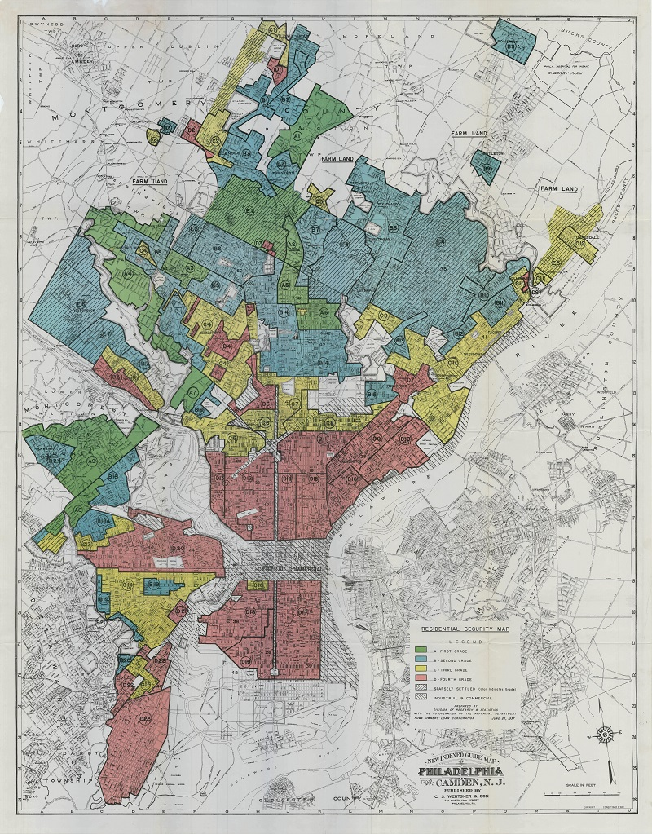
Redlining in Philadelphia
Color-coded maps ranked the loan worthiness of neighborhoods
Neighborhoods were ranked from least risky to most risky — areas where property values were most likely to go down were marked red
Notes:
Redlining --

Slide 12
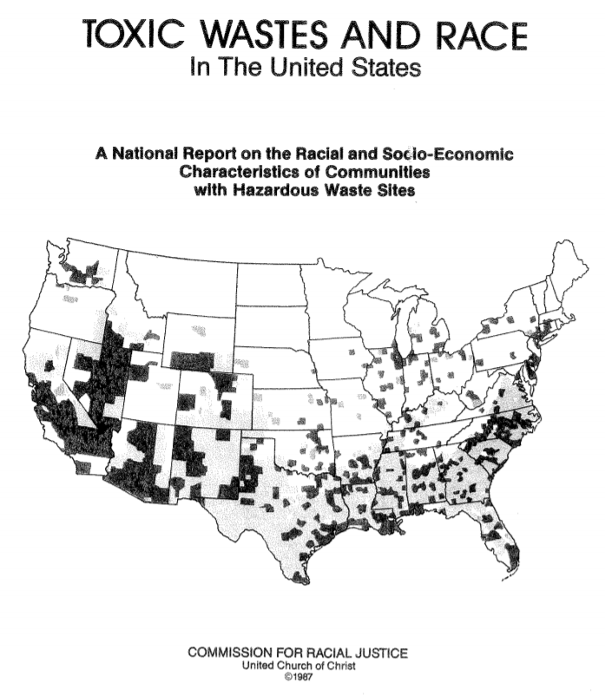
Found race to be the most significant predictor of where hazardous waste facilities were located in the US
Communities with higher percentages of minority populations were more likely to be chosen as sites for toxic waste facilities

Slide 13
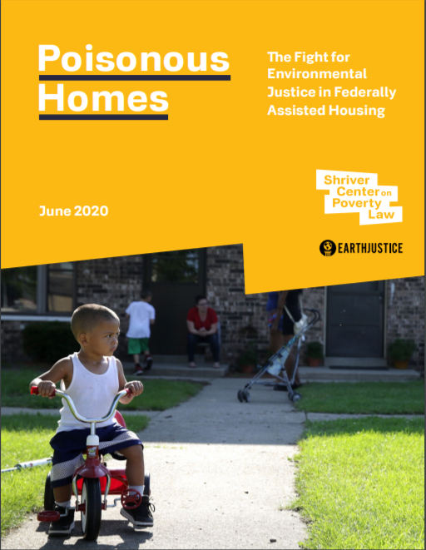
Environmental Injustice in 2020
70% of Superfund sites are located within one mile of federally assisted housing

Slide 14
Environmental Justice
Executive Order: President Clinton 2/11/1994
Made achieving environmental justice part of the mission of every federal agency
Each agency is to identify and address, as appropriate, disproportionately high and adverse human health or environmental effects…..on minority populations and low income populations.

Slide 15
eMapPA: Environmental Justice Areas

Slide 16
Rates of Hospitalization for Asthma in PA
10 Highest Counties
10 Lowest Counties
Philadelphia County 53.9
Lawrence County 26.2
Delaware County 25.5
Allegheny County 20.6
Fayette County 20.3
Westmoreland County 19.8
Indiana County 19.5
Wyoming County 18.8
Greene County 17.4
Beaver County 16.8
Sullivan County 3.5
Union County 3.5
Snyder County 3.9
Warren County 5.0
Perry County 5.7
Pike County 6.0
Bedford County 6.1
Tioga County 6.8
Franklin County 7.0
York County 7.1
Red represents counties with Environmental Justice Communities

Slide 17
Lung Cancer Rates in PA
Counties Significantly higher than expected
Counties Significantly lower than expected
Both Men and Women
Philadelphia
Delaware
Allegheny
Crawford
Washington
Erie
McKean
Monroe
Men
NONE
Women
Snyder
Somerset
Bedford
Fulton
Lancaster
Cambria
Indiana
Red represents counties with Environmental Justice Communities

Slide 18
Disparate Exposure to Air Pollution
150 million Americans live in counties with unhealthful levels of either ozone or particle pollution*
74 million of these are people of color*
Inadequate regulatory protections of all people
No regulatory mechanism to evaluate cumulative exposure
* American Lung Association State of the Air Report 2020
Notes:
Stop after –
1-2 more slides, then EJ screen

Slide 19
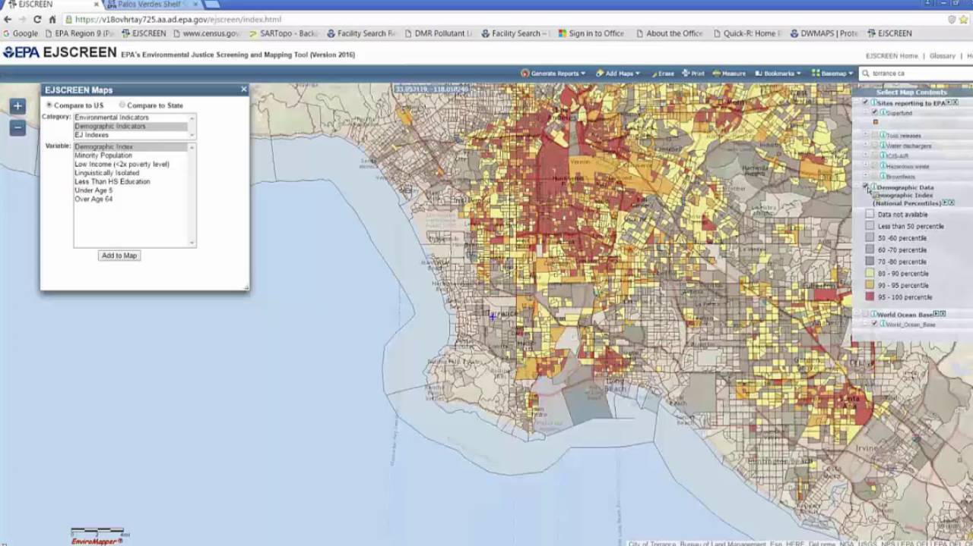
EJScreen Activity
EPA's environmental justice mapping and screening tool
Users choose a geographic area and this tool provides information on:
Age, race/ethnicity
Socioeconomic factors
Environmental factors
EJScreen combines indicators into EJ indexes

Slide 20
EJ Screen: Environmental Justice Index
EJ Indexes are given in percentiles compared to state or national data.
Highest
Lowest
Notes:
Add graphic, building getting bigger (10), if at the 60th percentile you would be this … 80th percentile …

Slide 21
EJ Screen: Environmental Justice Index
EJ Indexes are given in percentiles compared to state or national data.
Highest
Lowest
60th Percentile
Notes:
60% of the cities in the US have lower exposure to this risk
This city has a higher EJ index then 60% of the cities in the US

Slide 22
EJ Screen: Environmental Justice Index
EJ Indexes are given in percentiles compared to state or national data.
Highest
Lowest
80th Percentile
Notes:
80thpercentile, a common interpretation is that only 20% of the indexes were higher

Slide 23
EJScreen Activity
Create Reports
Use this tool to explore EJ Indexes in different neighborhoods in Philadelphia
Explore reports using a 1-mile radius around:
Grays Ferry (EJ index: traffic proximity, air toxic cancer risk)
Imhotep (EJ Index: particulate matter 2.5, ozone)
https://ejscreen.epa.gov/mapper/

